Slide 1
GOES-R Fire Characterization, Land Surface Temperature and Snow
Scott S. Lindstrom
Cooperative Institute for Meteorological Satellite Studies (CIMSS)
University of Wisconsin-Madison
Notes:
This is the Satellite Foundation Course for GOES-R Training on three surface-related Baseline Products: Fire Products, developed in part by Chris Schmidt at CIMSS, Land Surface Temperature products developed by Yunyue Yu at NOAA, and Snow Coverage products developed in part by Jeff Key at NOAA. I'm Scott Lindstrom and I will be guiding you through this training.

Slide 2
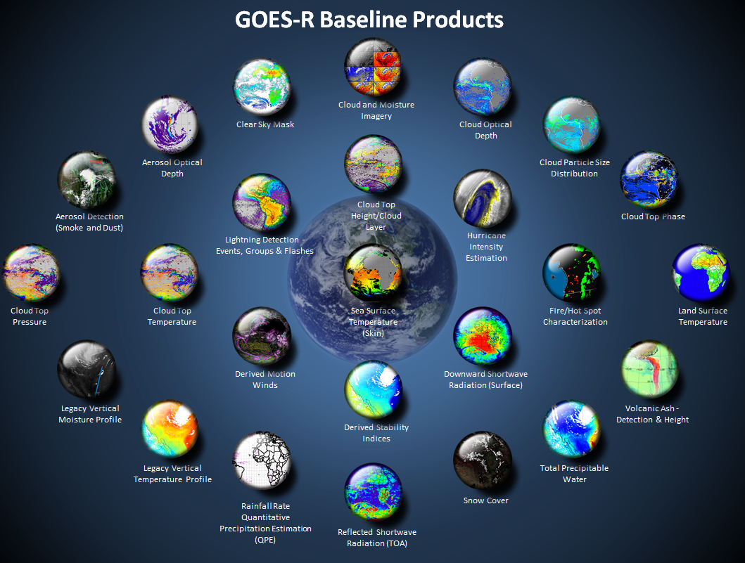
Fire
Detection
Land Sfc
Temperature
Snow Cover
http://www.goes-r.gov/products/baseline.html
Notes:
This training covers the products boxed in Yellow on this slide. They are Baseline products and are available from GOES-16 now. At the end of this training you will know the temporal cadence of the product generation and how the products, Fire Detection, Land Surface temperature, and Fractional Snow Cover, are created from GOES-R ABI data, and how they can be used.

Slide 3
Fire AWIPS Products in this training
Fire Area
Fire Power
Fire Temperature
Refresh Rate:
  CONUS: Products Created Every 5 minutes
  Full Disk (FD): Products Created Every 15 minutes
  MESO: Products not created (but fires can be monitored in visible and near-infrared band imagery)
Otherwise Known As….
  Fire Detection and Characterization Algorithm (FDCA)
  HotSpot Detection
  WF_ABBA (Wildfire Automated Biomass Burning Algorithm)
Chris Schmidt, CIMSS, is the Subject Matter Expert on this product
Notes:
The Fire products that are available in AWIPS are Fire Area, Fire Power and Fire Temperature. These are created every 5 minutes for the CONUS domain, and every 15 minutes for the Full Disk Domain. That means they're created for every Full Disk and CONUS image available. What is now known as FDCA -- Fire Detection and Characterization Algorithm, one of the topics of this training -- is very similar to the WF_ABBA algorithm you may be familiar with. They both deal in HotSpot Detection

Slide 4
How Does Fire Detection and Characterization Work?
Almost all Fire Detection algorithms use at least 2 IR bands: ~3.9 µm and ~11 µm. A threshold temperature difference between the two is used to flag potential fires
Requires some additional information (amount of water in the atmosphere, the surface composition and emissivity).
Algorithm is contextual to best handle estimating what the surface looks like without a fire – that information is needed for the algorithm to estimate the intensity of the fire.
Fires are always smaller than a GOES pixel, so there are limits to how well they can be characterized. Diffraction of the infrared light into the detector and uncertainty in the satellite navigation are the biggest factors.
Notes:
FDCA detects fires that are always smaller than the size of a pixel. Fire detection uses the shortwave and longwave infrared bands. Hot fire temperatures emit more 3.9 micrometer radiation than 11.2 micrometer radiation, and this enhanced 3.9 micrometer emission is key to fire detection. There are other variables that are needed in the computation to assess how this signal is modulated by the atmosphere.

Slide 5
FDCA with the ABI
Fire Detection and Characterization Algorithm
ABI’s excellent spatial resolution (2 km) in the short and long-wave infrared window bands (3.9 μm and 11.2 μm – Channels 7 and 14) means the minimum detectable size of a fire burning at an average temperature of 400 K is approximately 0.004 km² at the sub-satellite point in clear sky conditions
A Delta-T between 3.9 μm and 11.2 μm Brightness Temperatures of at least 4 K must be present
0.64 μm and 12.3 μm data (Channels 2 and 15) are used to screen for clouds: FDCA does not use the Baseline Clear Sky Mask
ABI : Full Disk coverage every 15 minutes and CONUS coverage every 5 minutes to ensure that even short-lived burning can be monitored
TPW and Surface Emissivity are used to judge how the fire signal is affected by the Earth/Atmosphere system.
Notes:
ABI has excellent spatial and temporal resolution (and good spectral resolution too!) The Shortwave IR band on GOES-R ABI has a very high saturation temperature, so hotter fires can be more accurately described. The improved spatial resolution means smaller fires can be detected, and more frequent scanning also aids in fire detection. Requirements for the Algorithm are listed on this slide. Visible data are also used to help determined the background Temperature.

Slide 6
How short and long-wave IR bands are used to detect & characterize fires
When the surface temperature warms, the Planck function peak shifts toward shorter wavelengths; radiance increases more rapidly at ~3.9 µm than at ~11 µm. Different brightness temperature responses in these two infrared windows and background conditions are used to detect fires and estimate sub-pixel fire size, temperature and fire radiative power (FRP).
Terms
The Planck function: Describes emitted energy at a given temperature / wavelength. (The curves in the plot above)
Radiance: A measure of the emitted energy (The y axis in the plot above)
Brightness Temperature: The temperature sensed by the detector, it is wavelength dependent and not the same as the bulk temperature of the surface or fire.
Notes:
The shortwave IR channel has a much larger response to the development of fire within a pixel than does the longwave IR channel. Surface temperature warming in the pixel -- because of a developing fire -- shifts the Planck Function peak to shorter wavelengths a lot more rapidly for 3.9 micrometers (band 7) than for 11.2 micrometers (band 14) The Response in the pixel differs for each fire, and those differences help in the estimate of fire attributes.

Slide 7
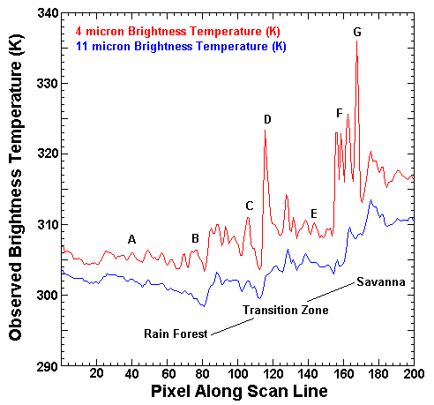
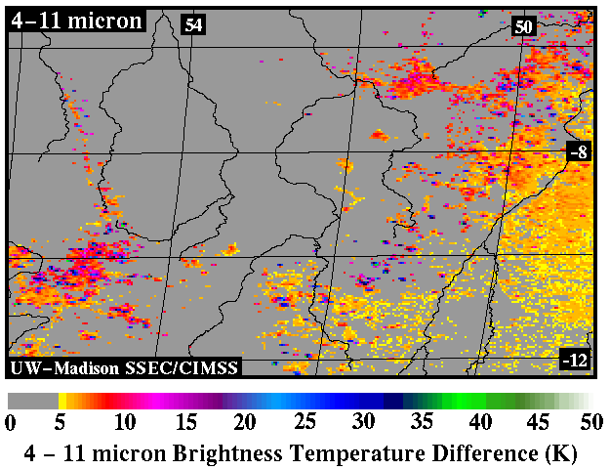
Fires are sub-pixel entities and IR responses to fires:
Differences in brightness temperatures between two infrared windows are due to reflected solar radiation, surface emissivity differences and water vapor attenuation that result in brightness temperature differences of 2-4 K.
Larger differences occur when one part of a pixel (p) is substantially warmer than the rest of the pixel (1-p). The hotter portion will contribute more radiance (energy) in shorter wavelengths than in the longer wavelengths. (This is known as a sub-pixel effect)
Pixel
p
1-p
3.9
Possible fires
Transition Zone
3.9 μm
11 μm
NE Brazil along the transition zone between forest and savanna
Brightness temperatures along a scan line in NE Brazil
Notes:
Again, Fires are small, compared to a satellite pixel, even with 2-km pixel sizes, and fires contribute more energy in shorter wavelengths than in longer wavelengths. SO when a fire develops, the changes are more obvious in the 3.9 micrometer channel (in red) than in the 11-ish micrometer channel (shown in blue). Compare the two channels here. Value differences help establish that a fire has likely initiated at A, B, C, D, E, F and G, especially D and G. Similarly, The larger values in the surface plot help identify where fires are occurring in the transition zone between forest and savannah in Brazil.

Slide 8
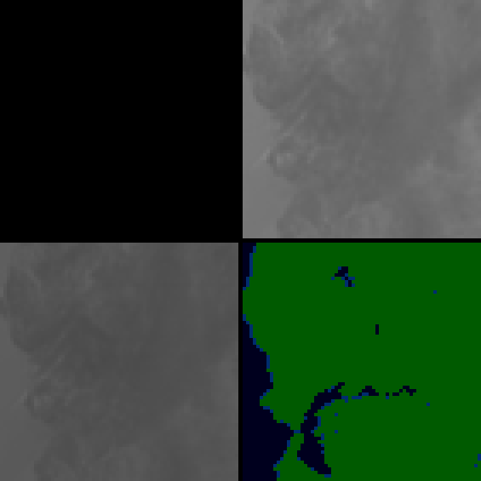

Fire detected in 3.9 μm – and it shows up first there
9:37 PDT
(4:37 UTC) October 8, 2017
0.64 μm
3.9 μm
11.2 μm
Notes:
Here's an example of a quickly developing fire over Napa Valley California. It demonstrates why 5-minute imagery is important, and how quickly things can change. At 0437 UTC, no fire is apparent.

Slide 9

9:42 PDT
(4:42 UTC) October 8, 2017
0.64 μm
3.9 μm
11.2 μm
Notes:
5 minutes later, two different hotspots have appeared in the 3.9 micrometer data (but not in the 11.2 micrometer data)

Slide 10
9:42 PDT
(4:42 UTC) October 8, 2017
0.64 μm
3.9 μm
11.2 μm
Notes:
Here's the same scene without the circles.

Slide 11

9:47 PDT
(4:47 UTC) October 8, 2017
0.64 μm
3.9 μm
11.2 μm
Notes:
At 0947 UTC, 5 minutes later, the spots are even hotter, and FDCA has identified a processed fire - that would show up in AWIPS Fire Temperature and Fire Area and Fire Power - and a high Possibility fire - that would show up only in Fire Power.

Slide 12

9:52 PDT
(4:52 UTC) October 8, 2017
0.64 μm
3.9 μm
11.2 μm
Notes:
AT 0952 UTC, 10 minutes after first being detected by the 3.9 micrometer channel, two fires are identified. Note that the fire is hot enough that a very subtle signal is showing up at 11.2 now as well.

Slide 13

9:57 PDT
(4:57 UTC) October 8, 2017
0.64 μm
3.9 μm
11.2 μm
Notes:
At 0957 they continue to intensify

Slide 14

10:02 PDT
(5:02 UTC) October 8, 2017
0.64 μm
3.9 μm
11.2 μm
Within 20 minutes of first becoming apparent, the fire has grown markedly and saturated the sensor
Notes:
By 1002 UTC, the hotter fire has saturated the sensor. Fires can grow very big, very fast. The FDCA can allow for early detection of rapidly growing fires, which detection can be used to heighten situational awareness including communication to first responders.

Slide 15
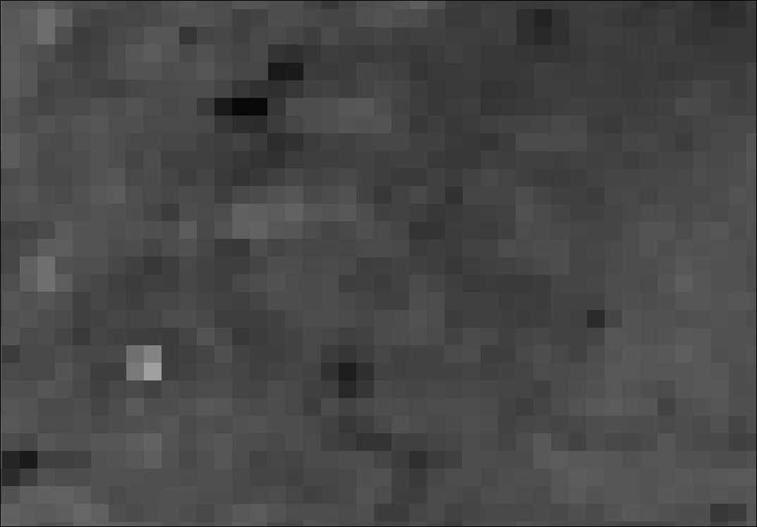
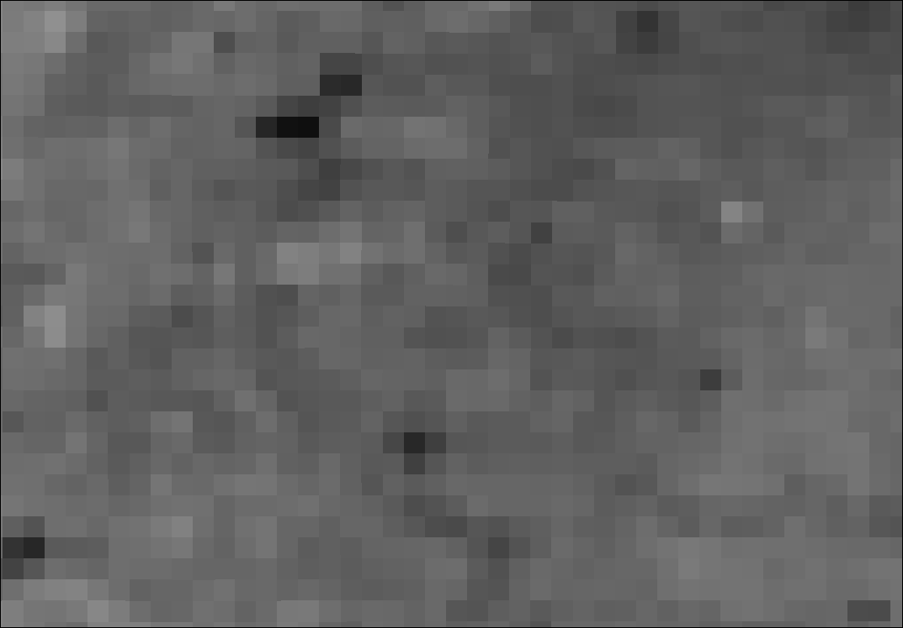
3.9 μm channel is very sensitive!
16:42:22 UTC
16:50:22 UTC
Oklahoma, 6 March 2018, imagery from 1-minute scans
Two fires: a larger one in the lower left that barely reaches the minimum threshold for quantitative detection, and the single structure fire in the upper right that exceeds background by ~ 1 K: it was not strong enough for quantitative detection.
If you know the background, and tweak the enhancement, you might see the fires before FDCA does
Notes:
The 3.9 micrometer sensor is very sensitive to fires, as this image from two separate time shows – Both of these brighter regions are very short-lived (and very small – this one is actually a small structure fire!) within the pixel. Only the fire at 16:42 was warm enough – just barely – to be detected quantitatively.

Slide 16
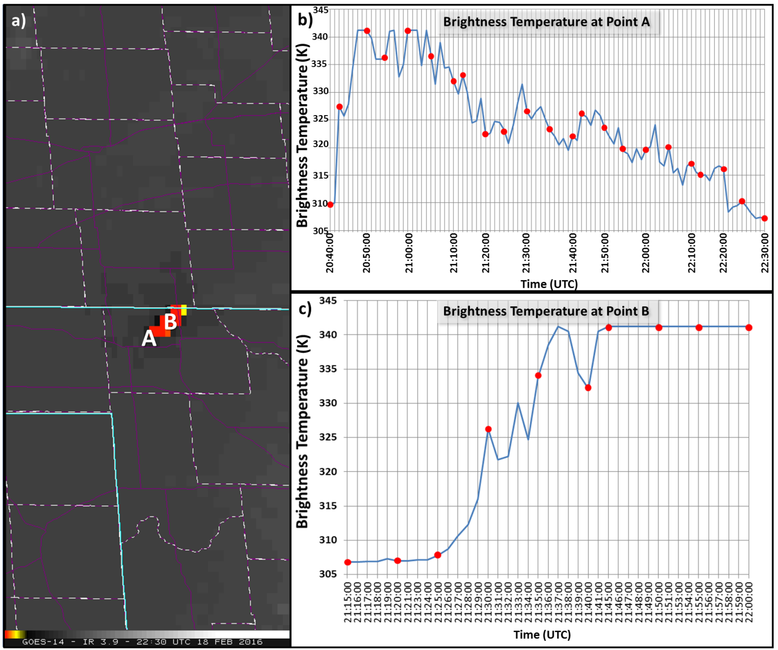
1-minute data monitors the quick changes in fires that occur
The graphs at right show one-minute brightness temperature traces (in blue) along with 5-minute values (in red). For rapidly-evolving fires, 5-minute imagery can miss changes, but FDCA values are not computed for MESO sectors with 1-minute information.
(Source)
1-minute trace
5-minute points
Notes:
Fires develop and evolve and/or move very quickly. ABI scans CONUS every 5 minutes, producing fire products with that cadence. FDCA products are not produced for Meso domains. To monitor fires at smaller time scales, request a mesoscale domain to capture the changes in the 3.9 micrometer data at 1-minute timesteps!

Slide 17
Other ways to detect fires
‘Fire RGB’
  Red: 3.9 μm ; Green: 2.25 μm ; Blue: 1.61 μm
  Fire starts: Mostly 3.9 μm emissions, red pixel
  Fire intensifies, getting warmer: more 2.2 μm emissions, pixel changes from red to orange to yellow
  Fire gets even hotter: more 1.6 μm emissions, pixel changes from yellow to white
Smoke in the visible (‘Blue’ band – 0.47 μm – is better able to distinguish scattering phenomena)
Polar orbiting satellites (Much better spatial resolution, but temporal resolution can be a challenge)
  Suomi-NPP and NOAA-20
  Horizontal Resolution down to 375 m!
Notes:
There are other ways to detect fires. The fire RGB in AWIPS combines the 3.9, 2.25 and 1.6 micrometer channels. A developing fire will appear red (redder than the background), and then as it burns hotter and hotter, progressively more 2.25 micrometer energy is emitted (turning the pixel yellow) and then 1.61 micrometer energy means the pixel becomes white. You can also use visible imagery, but smoke detection via the visible can be a challenge, depending on the background. Polar orbiting satellites – Suomi NPP and NOAA-20 – have very small spatial resolutions that are ideal in detecting small horizontal-scale fire. Use them if you are fortunate and have an overpass at the right time! (this is far more likely as you move poleward).

Slide 18
Land Surface Characteristics / Snow in this training
Land Surface Temperature
  Computed hourly in FD, CONUS, and Meso domains
  2-km resolution for CONUS and Meso domains
  10-km resolution for FD domain
Snow Cover (Not yet being created: Requires an Option 2 product – Surface Reflectance – that is still being developed)
  Computed hourly in FD, CONUS and Meso domains
  2-km resolution for FD, CONUS and Meso domains
Notes:
Switching topics now to land surface characteristics and fractional snow cover, two additional GOES-R Baseline Products.
Land Surface Temperature is computed hourly in all three domains, Full Disk, CONUS and MESO. CONUS and MESO domain resolution is 2-km; The Full Disk domain has a resolution of 10 km, that is, an aggregation of a 5x5 array of 2-km pixels.
Snow Cover -- fractional snow cover -- will be computed hourly for full-disk, CONUS and Mesoscale domains, at 2-km resolution. As of late 2018, it is not yet being created.

Slide 19
Land Surface Temperature
Uses a Split Window Technique, with Bands 14 and 15 (11.2 and 12.3 μm)
Computed where Local Satellite Zenith Angle < 70º
Computed hourly for FD, CONUS and Meso sectors
  This temporal cadence is insufficient for quickly-evolving phenomena, like (for example) Santa Ana winds. For those you might want to use just the 3.9 μm brightness temperature
Includes Lake Surface Temperatures
Range from 213 – 330 K
  Horizontal Resolution 2 km for Meso/CONUS, 10 km for FD
Created for “Clear” and “Probably Clear” pixels
Datasets required: Land/Sea Mask, Surface Emissivity, NCEP Water Vapor
  Error Sources: Surface Emissivity and Water Vapor Absorption
  Adjustments are also made for Zenith Angle
Notes:
Land surface temperature is computed from two ABI bands. You generally cannot use a single infrared channel to compute land surface temperature because water vapor absorption in most channels on ABI means that the detected temperature is cooler than the actual ground because energy emitted from the surface is absorbed, partially, by water vapor and re-emitted from a higher (and therefore colder) part of the atmosphere. (At shorter wavelengths - around 3.9 micrometers, you face the additional challenge of reflected solar energy).
Land surface temperature uses infrared data from 11.2 and 12.3 micrometers (bands14 and 15) on ABI. Water vapor absorption is different at these two wavelengths so a water vapor correction can be computed for either detected brightness temperature. Land Surface Temperature is computed hourly for the FD/CONUS/MESO domains. The differences in brightness temperature does consider the different dependencies on zenith angle for the two channels.

Slide 20
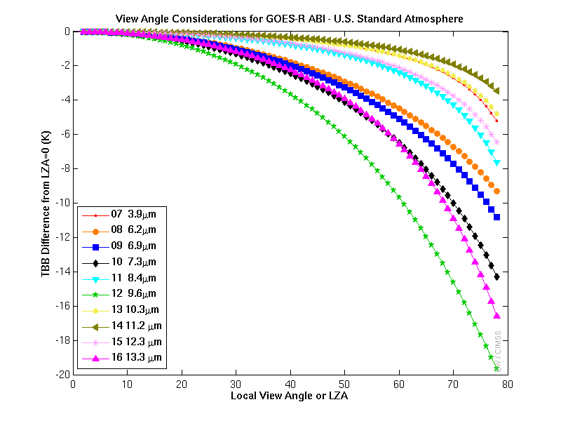
Zenith Angle Differences
Cooling due to water vapor as a function of zenith angle varies with wavelength. Cooling is greater for the 12.3 μm than for the 11.2 μm. A split window difference using these two bands accounts for this
No LST retrieval if SZA > 70º
Notes:
This figure shows cooling in each GOES-R ABI Infrared band that is a function of local zenith angle only. In general, as the local zenith angle increases -- that is, are you get farther and farther from nadir -- brightness temperatures will be cooler because more of the radiation detected from the satellite is emitted from the cooler upper atmosphere.
In particular, for Land Surface Temperature, band 15 (12.3 microns) shows greater cooling for larger zenith angle than band 14 (11.2 microns)

Slide 21
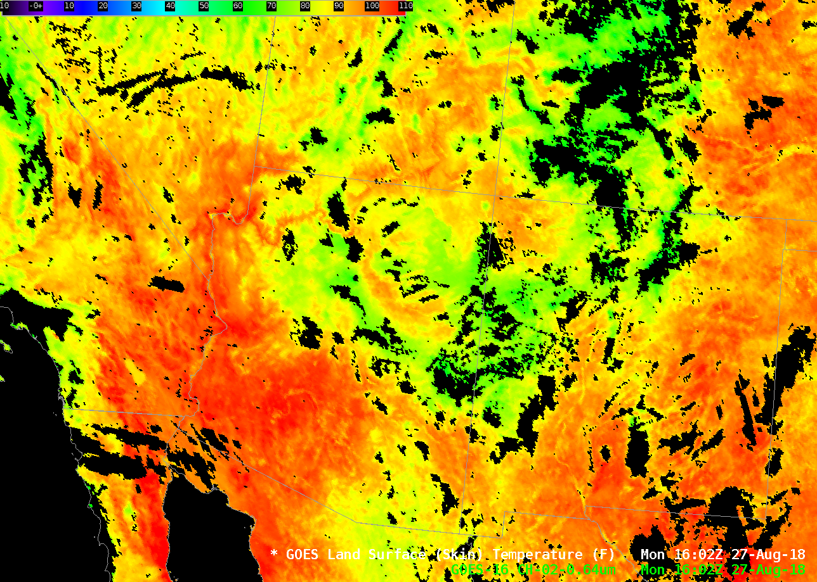
Land Surface Temperature
LST is computed every hour. Note that higher terrain and river valleys show up as cooler, as expected. This is something that is handy during the cold season for identifying regions of near-freezing temperatures
Notes:
Here is GOES-16 Land Surface Temperatures over the southwestern United States. Clouds (and oceans!) show up as missing data -- but lakes and inland seas do show values. River valleys (cooler) and and mountain ridges are apparent. Usually, the land surface temperature is warmer than colocated METAR values that are recorded about 6 feet above the surface.

Slide 22
Snow Cover
Binary Product: ‘Snow’ or ‘No Snow’; also a Fractional Pixel Snow Coverage Value
  The Fractional Snow Cover is computed using a spectral mixing model that computes the subpixel area of snow and of other surface types
Snowcover Retrieval uses a Spectral Mixing Model with Visible and near-IR bands on ABI (0.47 μm, 0.64 μm, 0.86 μm, 1.6 μm, 2.25 μm) (doesn’t use the 1.4 μm)
Requires a Cloud Mask
Horizontal Resolution of 2 km
Produced every 60 minutes
This product requires an Option 2 Surface Reflectance Product that is not yet being created
Notes:
Snow Cover is also Baseline product for GOES-R, but it's not yet being created. This is a daytime only reflectance-driven product. There is a snow/no snow product but also a fractional pixel snow cover product. This will be produced every 60 minutes for all domains - Full Disk, CONUS, Meso - at 2-km resolution.

Slide 23
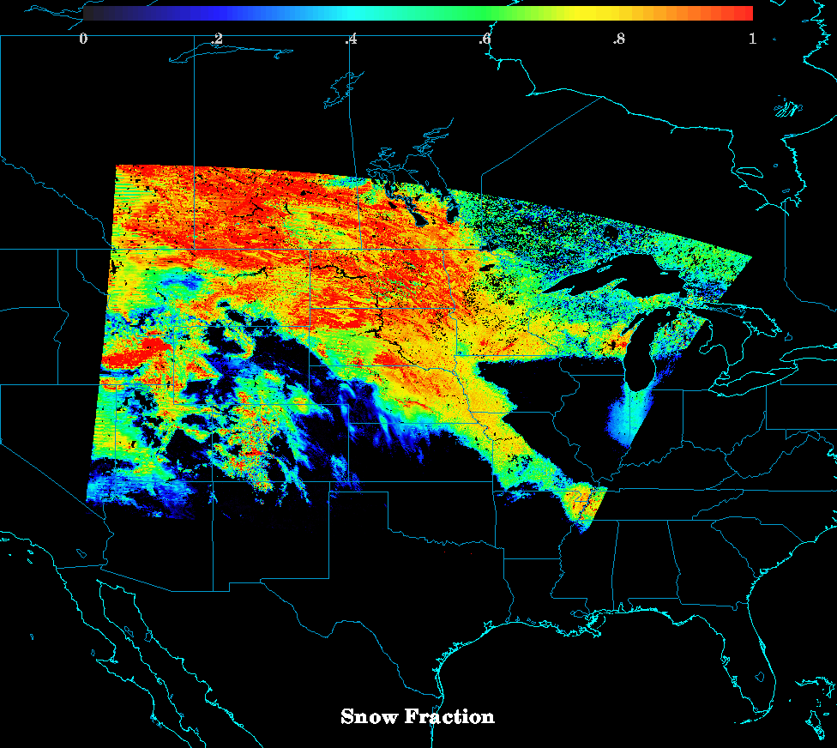
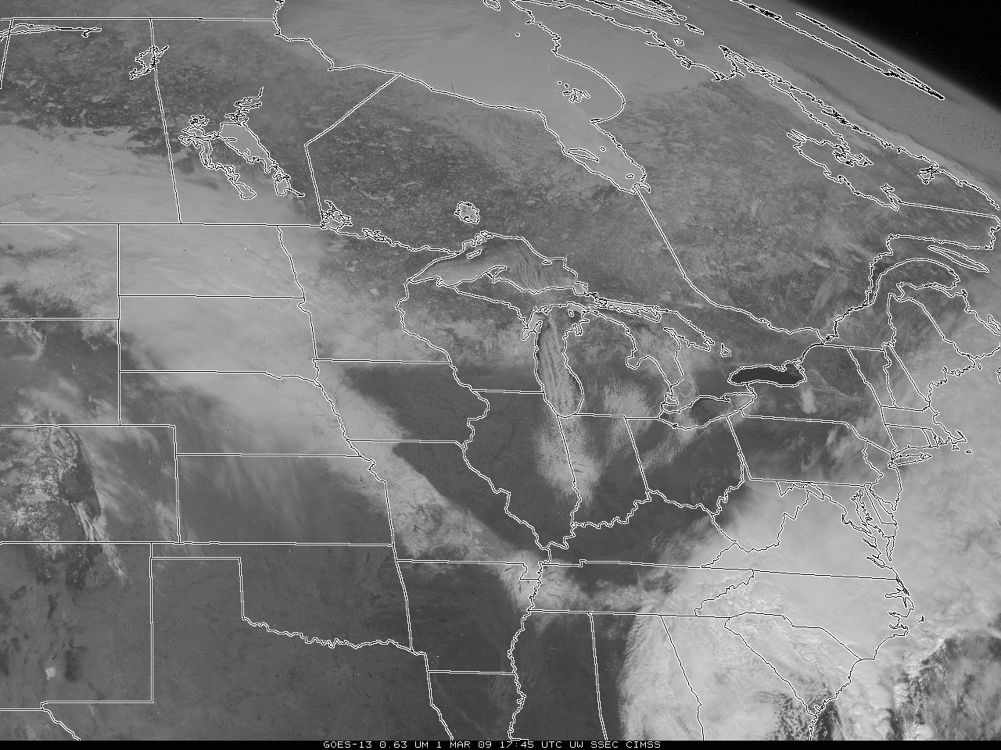
What does the Snow Cover look like?
ABI Snow Fraction
computed with
MODIS data
GOES-13 Visible Imagery 1 March 2009
Notes:
here's an example of what the product might look like, using MODIS data from a case on 2009.

Slide 24
Internet Resources
Surface Temperature ATBD
Fire Detection ATBD
Snow Cover ATBD
GOES-R Website on Land Surface Temperature
GOES-R Website on Fire Hotspot Detection
Notes:
Click on these links for more information. This concludes the Satellite Foundation Course for GOES-R on the GOES-R Baseline Products for Fire, landsurface Temperature and Snow cover. Thanks for your attention!

