Slide 1
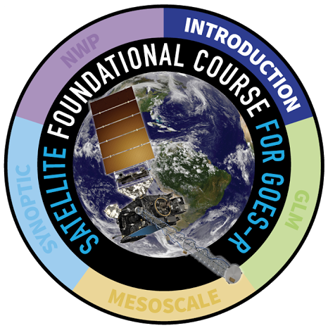
  Basic Operations of ABI on GOES-R
  Scan strategy and temporal refresh; Bands overview; Spatial resolution; Parallax; Bit depth; Operation of GOES-R and legacy GOES simultaneously
  Tim Schmit
  NOAA / ASPB
  Scott Lindstrom, Mat Gunshor
  UW-Madison CIMSS
Notes:
This Satellite Foundational Course for GOES-R will teach you what you need to know about the scanning of the Advanced baseline Imager, the ABI, on GOES-R. In addition, you'll learn about the improvements on ABI related to improved spectral, spatial and temporal resolution, how parallax can affect what you see, what the better bit depth on ABI means, and how multiple satellites with different resolutions will view North America. The authors of and contributors to this training are listed, and they all work at the University of Wisconsin Madison Cooperative Institute for Meteorological Satellite Studies.

Slide 2
Learning Objectives for this Module on ABI
(ABI: Advanced Baseline Imager: GOES-R’s Multi-spectral Sensor)
  Describe reflected solar and terrestrial radiation as they relate to satellite observations
  Explain how solar and terrestrial radiation is selectively absorbed, reflected, and scattered by atmospheric constituents
  Explain the processes of radiative transfer
  Explain selective absorption through the atmosphere
  Describe the improvements in spectral coverage, spatial resolution, and imaging intervals of the GOES-R ABI over the previous GOES imager.
  Identify the ABI's 16 spectral channels and the phenomena that can be detected in the spectral regions they cover.
  Describe the concept of parallax and how it impacts image interpretation.
  Describe the importance of adequate bit depth for all the ABI channels.
ABI: Advanced Baseline Imager: GOES-R’s Multi-spectral Sensor
Notes:
Learning Objectives for this module are listed on this screen. Take some time to read through them. Some of the radiation knowledge you will have learned about in other modules.

Slide 3
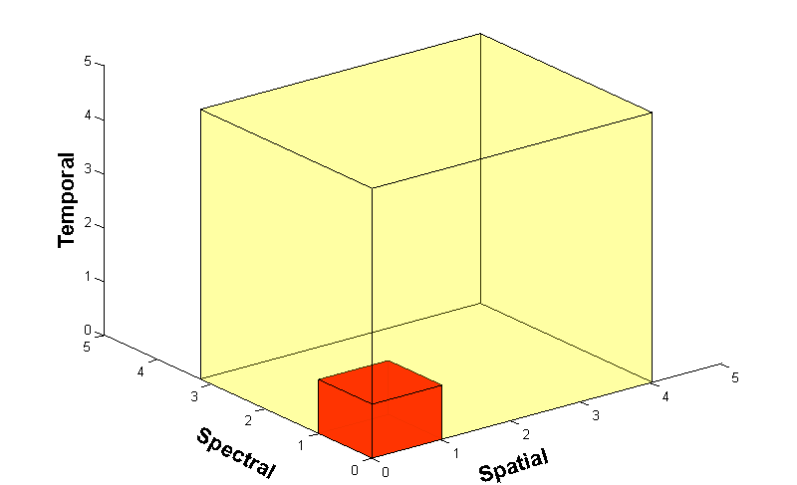
Advanced Baseline Imager
The ABI : a game-changing instrument, scanning more wavelengths faster and with better spatial resolution
ABI Data Volume
Legacy GOES Data Volume
5X
Faster coverage
(5-minute full disk vs. 25-minute)
4X
Improved spatial
resolution
(2 km IR vs. 4 km)
3X
More spectral bands (16 on ABI vs. 5 on legacy imager)
GOES-R sends almost 1 terabyte of data daily!! ~60-fold increase
There were considerable growing pains for storage/retention of this dataflow
Notes:
Slide from J. Gerth, CIMSS. There was an immense increase in the amount of data sent by the ABI compared to GOES-13 through -15. The ABI on GOES-R acquires a full-disk image 5 times faster than the imager on GOES-13 through GOES-15. Spatial resolution on the ABI compared to legacy GOES increased by a factor of 2 in both horizontal directions. And there are about 3x more spectral bands on GOES-R. The cubes represent the data volumes from legacy GOES, in dark orange, and the new GOES-R, in beige. The combination of increased resolutions meant at least 60-fold increase in data. This caused issues, mostly resolved, in storage and retention of data.

Slide 4
ABI Mode 3 (Flex mode)
‘White’ space in the graph is instrument idle time: 4+ minutes out of 15
Each CONUS scan takes 42 seconds total over the course of 2.5 minutes
This is the default Scanning Mode on GOES-16
This chart shows a series of 30-second strips over 15 minutes
Notes:
The default scan mode for GOES-16 in 2018 is Mode 3, or Flex Mode, shown here. The time-time chart shows when and where the ABI is scanning in strips of 30-second intervals across the top; sequential 30-second strips start at the left hand side. During the 15 minutes shown on this chart, one full-disk image is scanned, 3 CONUS images are scanned, and 1 meso sector is scanned 30 times (alternatively, 2 different meso sectors can be scanned 15 times). (Note that each CONUS image is acquired in only 48 seconds that are spread out over 3 minutes, but they start 5 minutes apart) White space on this chart is instrument idle time: no radiation is being sensed.

Slide 5
ABI Mode 4 -- (Continuous Full Disk)
This is the Continuous Full Disk (every 5 min) mode
This is the highest data rate. Only 1m 15s idle time each 15 minutes
Might be used in Single Satellite Mode (as is done today when GOES-East or GOES-West is non-functional: the other GOES switches to all full disk)
Notes:
This is a time-time chart of the Continuous Full Disk mode. This is the highest data rate for GOES-R's ABI. and results in a full disk every 5 minutes. No mesos can be scanned. This might be used if multiple high-impact weather/volcanic events are happening within the GOES-R footprint.

Slide 6
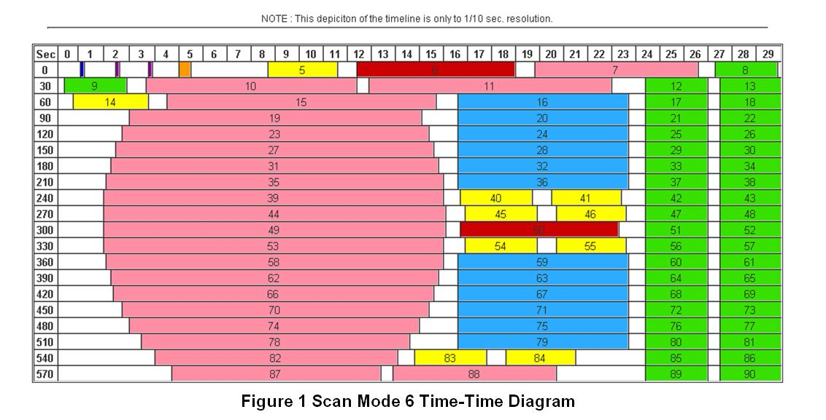
ABI Mode 6 -- (Tested in 2018)
This is a time-time chart over 10 minutes (the previous two showed 15 minutes of scanning)
Mode 6 allows for Full Disk images every 10 minutes vs. every 15 minutes for Mode 3 (and both have 5-minute CONUS and 1-,minute Mesos)
Notes:
If you look at the Mode 3 Time/Time chart on page 4 - there's a lot of 'white' space on that chart, or idle time for the instrument. There's so much idle time, in fact, that you can remove much of it and have 10-minute full disks(shown in pink) and still maintain 5-minute CONUS imagery (in blue) and 2 meso sectors (in green). This 'Mode 6' is being tested in 2018 for an eye to operations. 10-minute scanning would align with Japanese scanning with Himawari.

Slide 7
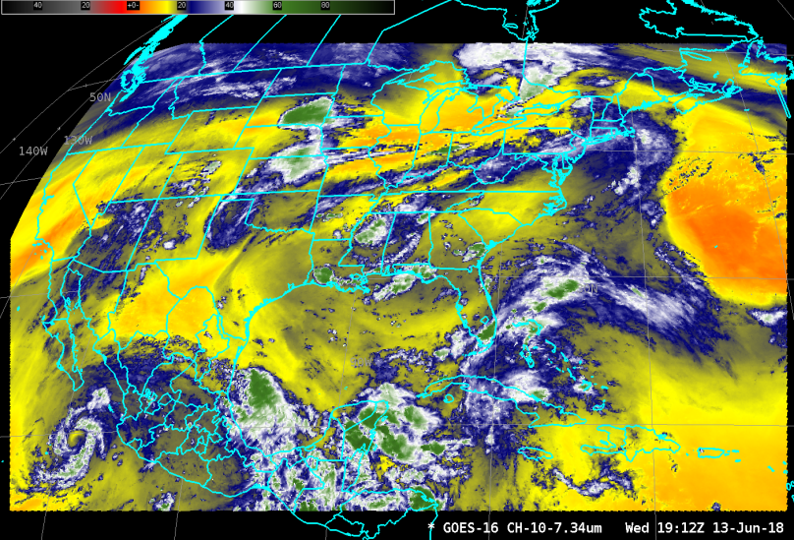
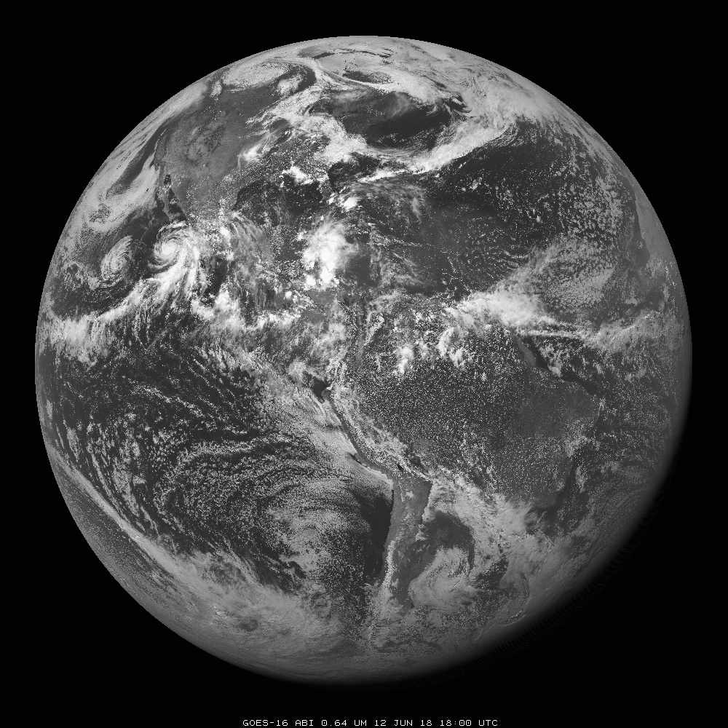
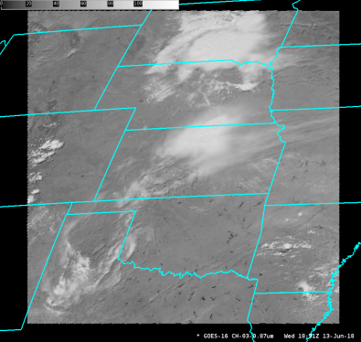
Baseline ABI Sectors
Flex Mode/Mode 3:
CONUS every 5 minutes
Flex Mode/Mode 3:
Full Disk every 15 minutes
Continuous Full Disk/Mode 4:
Full Disk every 5 minutes
Flex Mode/Mode 3:
2 Meso sectors every minute
(This example is over Kansas)
Notes:
But in 2018, The default scanning mode as of 2018 remains Mode 3; One full-disk image every 15 minutes, one CONUS image every 5 minutes, a 2 mesoscale sectors every minute. You can also overlay mesoscale images so you get 30-second scanning.

Slide 8
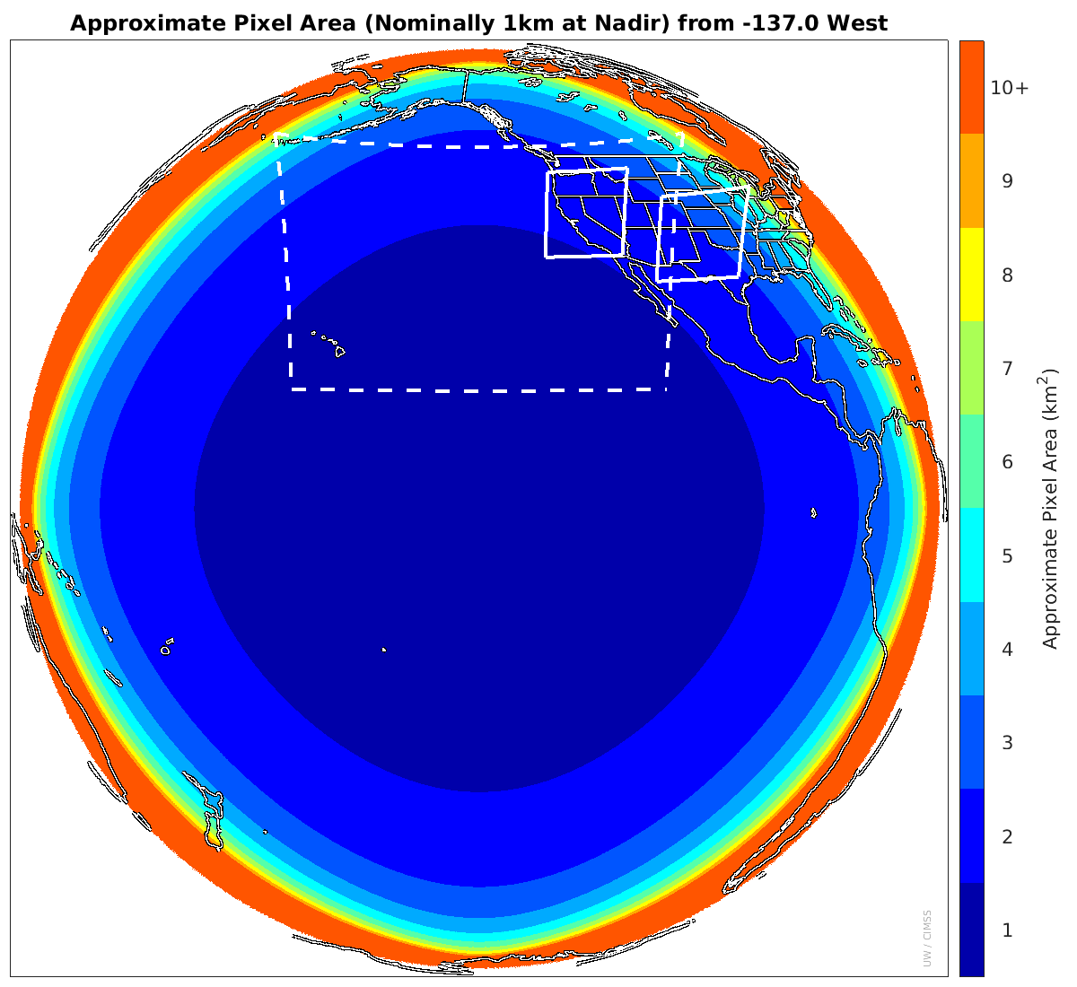
1 min
Meso-scale box locations are movable, default
locations
shown
1 min
5 min
15 min
GOES-17 as GOES-West (planned)
137 W
Notes:
This figure shows spatial resolution (Pixel Areas are approximate.) as a function of color (apologies to those in the audience with color deficiency) for GOES-R in the GOES-West position. CONUS and default Meso Sectors are shown. these mesos are moveable and have a 1000x1000km size (at the subsatellite point). The mesoscale regions have different sizes and shapes for different geographic locations -- but they have the same size in the number of horizontal lines scanned and the number of vertical elements scanned.
For Bands 1, 3 and 5 on ABI, A spatial resolution of 1 square kilometer occurs at nadir, the sub-satellite point. Each color bin is rounded to the nearest square kilometer. The first, dark blue ring labeled “1” shows pixel areas from 1 to 1.49km²; the next, lighter blue, shows pixel sizes between 1.5 and 2.5km² labeled “2”, and so on.

Slide 9
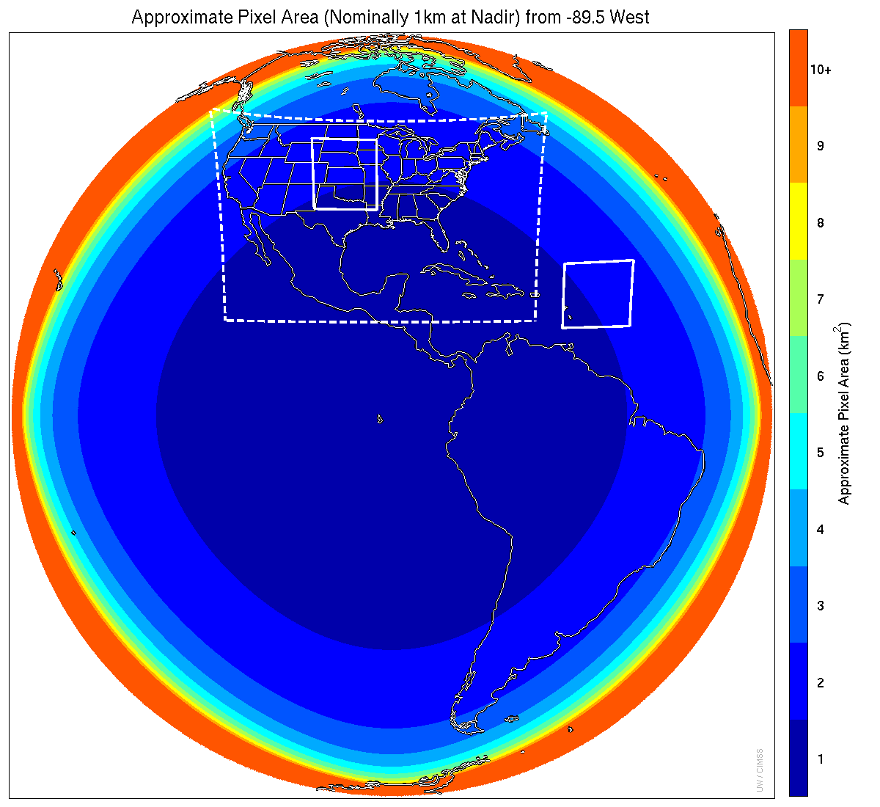
Meso-scale box locations are movable
1 min
5 min
1 min
15 min
GOES-R series satellites spend about a year at 89.5 for Post-Launch Testing and Checkout.
89.5 W
Notes:
This is the same figure for GOES-R in the central GOES-Test location with the CONUS sector indicated and Two meso-scale image sectors shown.

Slide 10
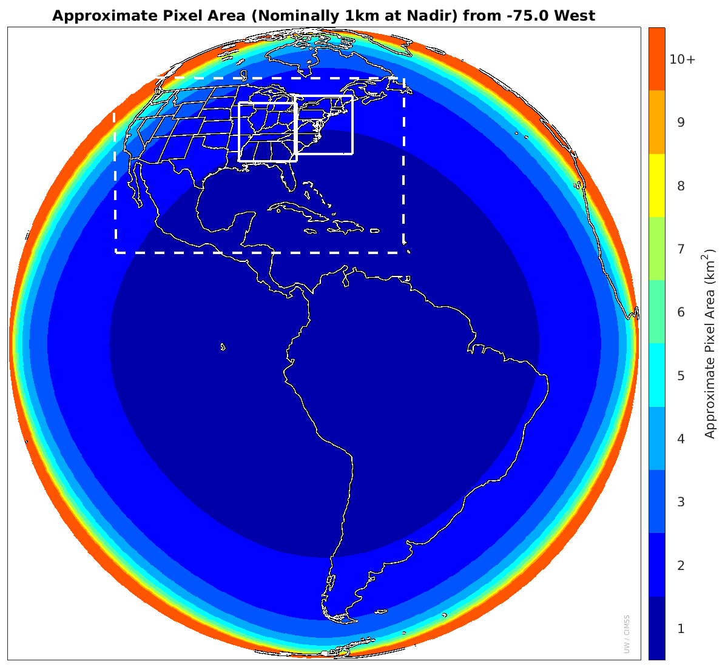
Meso-scale box locations are movable, default
locations
shown
1 min
5 min
1 min
15 min
GOES-16 as GOES-East
75.2 W
Notes:
Here is the figure for GOES-16 in the GOES-East location with the CONUS sector indicated. The default location of the meso sectors is shown, but they can be moved anywhere.

Slide 11
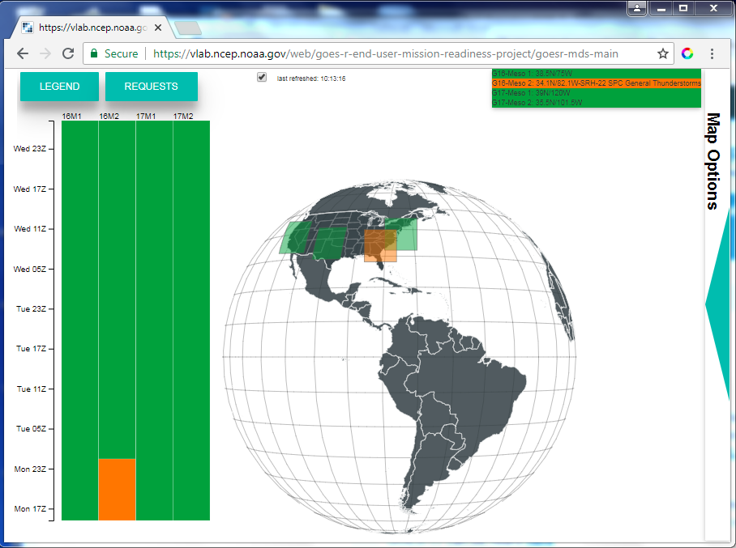
How do you position a Meso?
Consult with management to see how this is done in your WFO – there are differences between Regions. A link to the MDS display site (above) is in the STOR on VLab
Notes:
If you're in a WFO, and you want satellite imagery more than every 5 minutes (over CONUS) or more than 10-15 minutes (over Alaska) -- call a Meso! The methods to do this may vary by region, so ask Management how it's done. You can find a link to this site that displays current and planned meso sectors in the STOR on VLab.

Slide 12
The Advanced Baseline Imager: ABI
ABI
Spectral Coverage 16 bands
Spatial resolution
0.64 μm Visible 0.5 km
Other Visible/near-IR 1.0 km
Bands (>2 μm) 2 km
Spatial coverage
Full disk Every 15 minutes
CONUS Every 5 minutes
Mesoscale Every 30 sec
Visible (reflective bands)
On-orbit calibration Yes
Notes:
This table shows the better spectral, spatial and temporal resolution of The ABI
What does On-orbit cal mean for reflective bands? That means that GOES-east visible and GOES-West visible will look similar even as the satellites age.

Slide 13
ABI: Bands 1-16 (Visible /Near-IR/ IR)
ABI Band | Wavelength (µm) | Wavelength range (µm) | Sub-point pixel spacing (km) | Descriptive Name
1 | 0.47 | 0.45 - 0.49 | 1 | “Blue”
2 | 0.64 | 0.60 - 0.68 | 0.5 | “Red”
3 | 0.864 | 0.847 - 0.882 | 1 | “Veggie”
4 | 1.373 | 1.366 - 1.380 | 2 | “Cirrus”
5 | 1.61 | 1.59 - 1.63 | 1 | “Snow/Ice”
6 | 2.24 | 2.22 -2.27 | 2 | “Cloud Particle Size”
7 | 3.90 | 3.80 - 3.99 | 2 | “Shortwave window”
8 | 6.19 | 5.79 - 6.59 | 2 | “Upper-level Water Vapor”
9 | 6.93 | 6.72 - 7.14 | 2 | “Mid-Level Water Vapor”
10 | 7.34 | 7.24 - 7.43 | 2 | “Lower/Mid-level Water Vapor”
11 | 8.44 | 8.23 - 8.66 | 2 | “Cloud-top Phase”
12 | 9.61 | 9.42 - 9.80 | 2 | “Ozone”
13 | 10.33 | 10.18 - 10.48 | 2 | “Clean longwave window”
14 | 11.21 | 10.82 - 11.60 | 2 | “Longwave window”
15 | 12.29 | 11.83 - 12.75 | 2 | “Dirty longwave window”
16 | 13.28 | 12.99 - 13.56 | 2 | “CO₂”
Notes:
Based on Schmit et al, 2017. These are the 16 bands, the central wavelength, the wavelength range, the resolution and the band nickname.

Slide 14
ABI: Bands 1-6 (Visible / NearIR)
ABI Band | Wavelength (µm) | Wavelength range (µm) | Sub-point pixel spacing (km) | Descriptive Name
1 | 0.47 | 0.45 - 0.49 | 1 | “Blue”
2 | 0.64 | 0.60 - 0.68 | 0.5 | “Red”
3 | 0.864 | 0.847 - 0.882 | 1 | “Veggie”
4 | 1.373 | 1.366 - 1.380 | 2 | “Cirrus”
5 | 1.61 | 1.59 - 1.63 | 1 | “Snow/Ice”
6 | 2.24 | 2.22 -2.27 | 2 | “Cloud Particle Size”
Six visible or near visible bands on ABI, one on heritage imager
Notes:
Based on Schmit et al, 2017. the reflective bands shown here generally have little utility at night (except for the 1.6 and 2.2 micron channels that can have a signal for fires/volcanoes at night)

Slide 15
ABI: Bands 1-6 (Visible / NearIR)
ABI Band | Wavelength (µm) | Wavelength range (µm) | Sub-point pixel spacing (km) | Descriptive Name
1 | 0.47 | 0.45 - 0.49 | 1 | “Blue”
2 | 0.64 | 0.60 - 0.68 | 0.5 | “Red”
3 | 0.864 | 0.847 - 0.882 | 1 | “Veggie”
4 | 1.373 | 1.366 - 1.380 | 2 | “Cirrus”
5 | 1.61 | 1.59 - 1.63 | 1 | “Snow/Ice”
6 | 2.24 | 2.22 -2.27 | 2 | “Cloud Particle Size”
Indicates observations at this wavelength on previous GOES Imagers
Six visible or near visible bands on ABI, one on heritage imager
Notes:
Based on Schmit et al, 2017. Band 2 on ABI continues observations at 0.64 micrometers that were done on previous GOES imagers (that's what the star means -- that the band was on previous GOES). Note that Bands 1, 3 and 5 - the odd numbers, are the bands with 1-km resolution. Band 2 has 1/2 kilometer resolution -- the best!! -- and Bands 4 and 6 have 2-km resolution.

Slide 16
ABI: Bands 7-16 (IR)
ABI Band | Wavelength (µm) | Wavelength range (µm) | Sub-point pixel spacing (km) | Descriptive Name
7 | 3.90 | 3.80 - 3.99 | 2 | “Shortwave window”
8 | 6.19 | 5.79 - 6.59 | 2 | “Upper-level Water Vapor”
9 | 6.93 | 6.72 - 7.14 | 2 | “Mid-Level Water Vapor”
10 | 7.34 | 7.24 - 7.43 | 2 | “Lower/Mid-level Water Vapor”
11 | 8.44 | 8.23 - 8.66 | 2 | “Cloud-top Phase”
12 | 9.61 | 9.42 - 9.80 | 2 | “Ozone”
13 | 10.33 | 10.18 - 10.48 | 2 | “Clean longwave window”
14 | 11.21 | 10.82 - 11.60 | 2 | “Longwave window”
15 | 12.29 | 11.83 - 12.75 | 2 | “Dirty longwave window”
16 | 13.28 | 12.99 - 13.56 | 2 | “CO₂”
10 infrared bands on the ABI, four on heritage imager
Notes:
Based on Schmit et al, 2017. The infrared band on ABI. The number of IR bands has increased by a factor of 2.5, from 4 on legacy GOES to 10 on the GOES-R Series of satellites!

Slide 17
ABI: Bands 7-16 (IR)
ABI Band | Wavelength (µm) | Wavelength range (µm) | Sub-point pixel spacing (km) | Descriptive Name
7 | 3.90 | 3.80 - 3.99 | 2 | “Shortwave window”
8 | 6.19 | 5.79 - 6.59 | 2 | “Upper-level Water Vapor”
9 | 6.93 | 6.72 - 7.14 | 2 | “Mid-Level Water Vapor”
10 | 7.34 | 7.24 - 7.43 | 2 | “Lower/Mid-level Water Vapor”
11 | 8.44 | 8.23 - 8.66 | 2 | “Cloud-top Phase”
12 | 9.61 | 9.42 - 9.80 | 2 | “Ozone”
13 | 10.33 | 10.18 - 10.48 | 2 | “Clean longwave window”
14 | 11.21 | 10.82 - 11.60 | 2 | “Longwave window”
15 | 12.29 | 11.83 - 12.75 | 2 | “Dirty longwave window”
16 | 13.28 | 12.99 - 13.56 | 2 | “CO₂”
10 infrared bands on the ABI, four on heritage imager
Notes:
Based on Schmit et al, 2017. Stars appear approximately where GOES Imagers observed data in the past. Band 7 and 16 have close matches on legacy GOES imagers. The Water vapor channel and window bands on ABI are similar but not exact matches to legacy GOES.

Slide 18
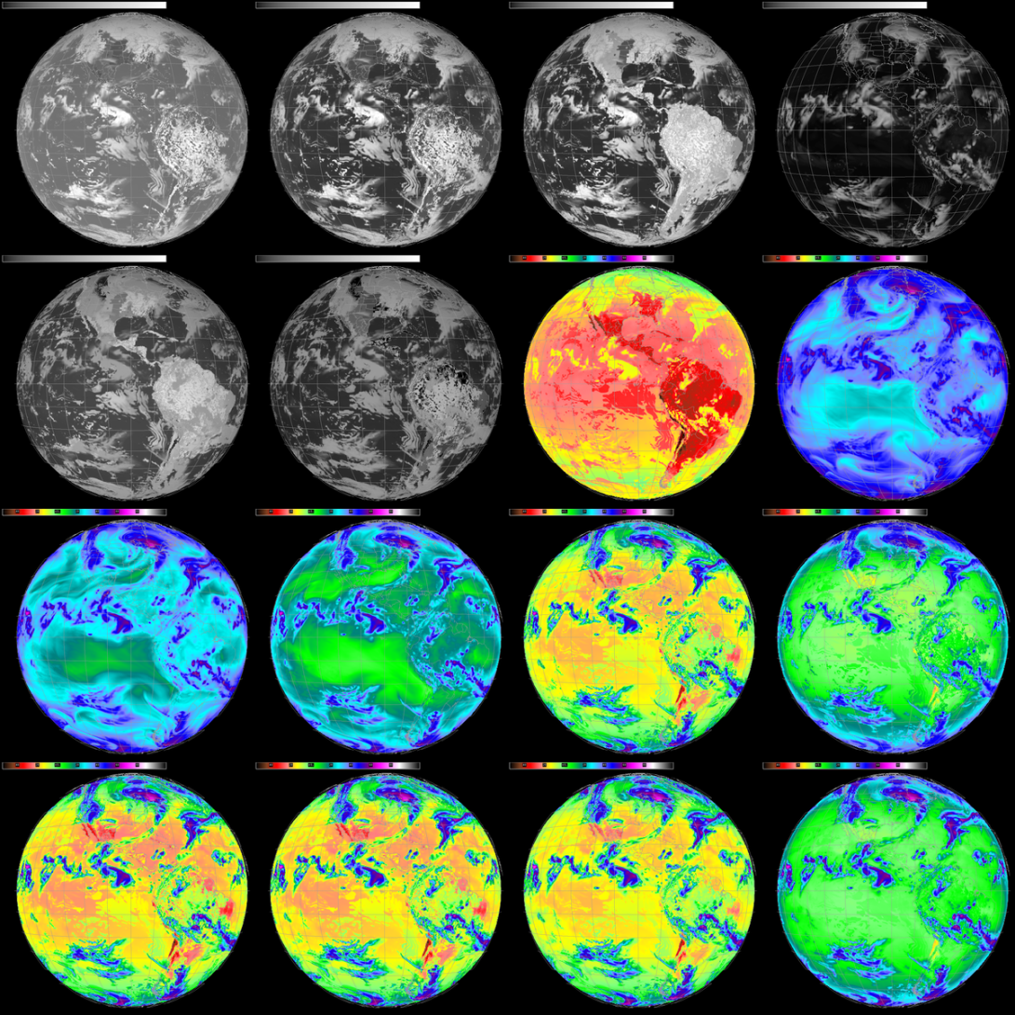
0.64 μm
3.9 μm
6.5 μm
10.7 μm
13.3 μm
Old Legacy GOES – 5 Channels, 1 VIS, 4 IR
Notes:
Here's a graphical image of legacy GOES bands,as they would be seen from the test position at 89.5 W, all 5 of them. Visible, Shortwave IR, water vapor, infrared window, and Carbon Dioxide.

Slide 19
0.47 μm
0.64 μm
0.86 μm
1.37 μm
1.6 μm
2.2 μm
3.9 μm
6.2 μm
6.9 μm
7.3 μm
8.4 μm
9.6 μm
10.3 μm
11.2 μm
12.3 μm
13.3 μm
GOES-R Series – 16 Channels, 2 VIS, 4 Near-IR, 10 IR
Notes:
Here's a graphical image of GOES-R bands, centered at 89.5 W. A lot more data flows from GOES-R!

Slide 20
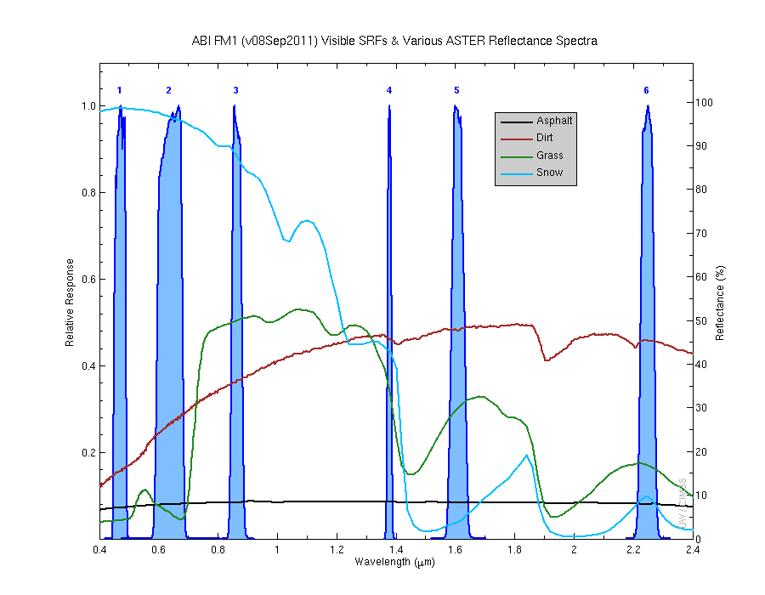
Visible and near-IR channels on the ABI
Cirrus, Dust
Snow, Phase
Clouds, Snow
Cloud Particle size
Aerosols, Insolation
Vegetation, Land/Sea
There are many other uses than the ones shown!
The ABI visible and near-IR bands have many uses.
Notes:
Schmit, T. J., M. M. Gunshor, W. P. Menzel, J. J. Gurka, J. Li, and A. S. Bachmeier, 2005: Introducing the next-generation Advanced Baseline Imager on GOES-R. Bull. Amer. Meteor. Soc., 86, 1079-1096. This shows the Spectral response functions for the The vis and near-IR bands, as well as reflectance for different surfaces. These ABI bands are useful mostly only during the day, with some exceptions for the 2.2 and 1.6 micron channels. Reflectivity differences between bands mean that what is evident in one band might not be in another band. For example, snow is bright white in the visible, but it's not very reflective at all at 1.6. Some sample uses for the bands are listed - but many more exist!

Slide 21
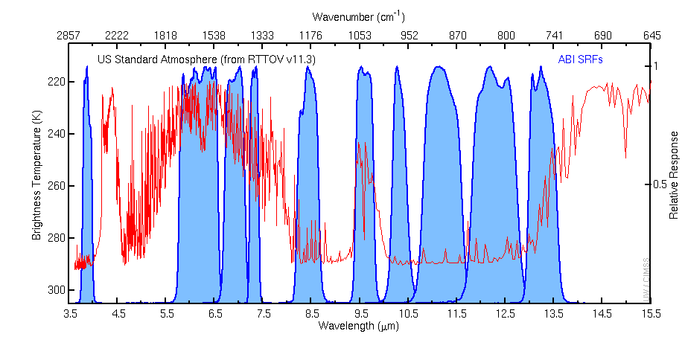
The IR channels (7-16) on the ABI
7
8
9
10
11
12
13
14
15
16
Shortwave window
Cloud-top Phase
CO₂
Upper-level Water Vapor
Ozone
Mid-Level Water Vapor
Clean Longwave window
Longwave window
Lower/Mid-level Water Vapor
Dirty longwave window
Notes:
Forward Model Used: RTTOV v11.3. The red line in this figure shows brightness temperatures that would be computed from satellite observations of a US Standard Atmosphere, at various wavelengths, assuming a clear sky. The spectral response functions for the infrared bands on ABI are also shown in blue as well as the band number, and the band nicknames. In some regions, around 10.3 micrometers, for example, atmospheric absorption is small and the computed brightness temperature is the surface temperature of the US Standard atmosphere. The satellite detects radiation that is emitted from the surface and escapes directly to space. In contrast, energy at 6.5 micrometers that leaves the surface is absorbed strongly by water vapor in the atmosphere, and then re-emitted from a higher (colder) region. At some point in the vertical, when water vapor no longer exists above a region, the re-emitted energy will escape un-absorbed to space, but it will be from a far colder region, so a colder temperature is shown. In addition to water vapor absorption, absorption by CO2, SO2 and Ozone is present.

Slide 22
The IR channels on the ABI
Cloud Phase, SO2
SST, Fires, Radiances
Hurricane, Imagery
Fires, Fog
Moisture, Aerosol
Winds, WV profiling
Clouds, Stability Indices
TPW, Rainfall rate
SO2, Radiances
Ozone
7
8
9
10
11
12
13
14
15
16
There are many other uses than the ones shown!
Notes:
Forward Model Used: RTTOV v11.3
ABI SRFs are Flight Model 1, version 2 (2014) The different bands (or channels) have different uses as listed on this chart, as shown here. There are lots of other uses too.

Slide 23
Parallax
Each pixel is navigated to a particular point, line-of-sight to satellite
If a Tall Cloud develops in that line-of-sight, that information is navigated to the ‘wrong’ pixel
Parallax effects increase as you move away from the sub-satellite point
Parallax effects increase as clouds get taller
Notes:
Switching topics now. Parallax is a well-known mis-navigation that happens when something (a cloud feature in the atmosphere) blocks the view of the surface.

Slide 24
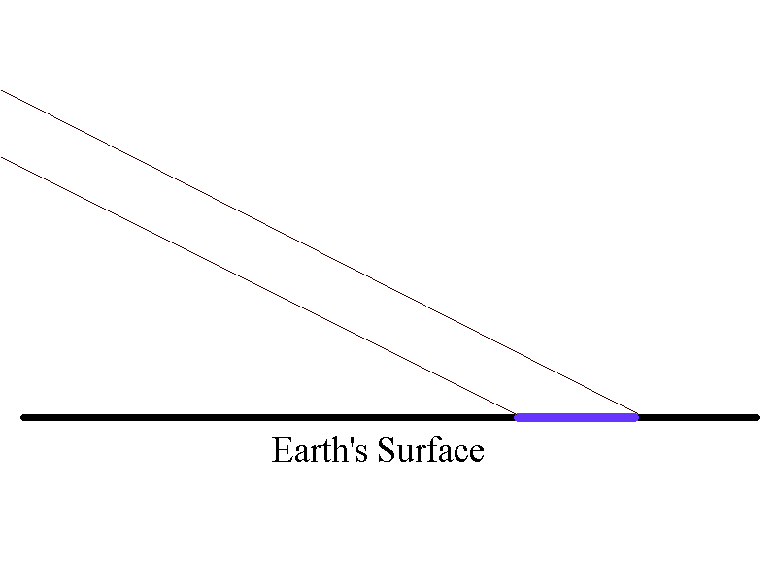
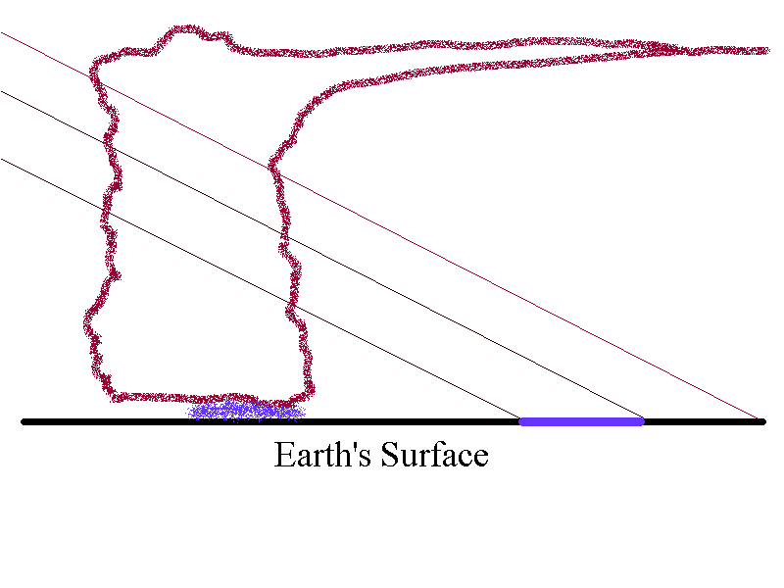
Satellite views the pixel – but what
happens when a cloud develops?
Cloud information is navigated to
the wrong point.
Error is proportional to both cloud
height and distance from nadir
Radiation detected from the side of the cloud is mis-navigated to a point farther from the sub-satellite point
Notes:
In clear conditions, satellite observations comes from the surface pixel, and is navigated to that point. All satellite navigation assumes clear skies. If a sensor is pointing in a particular direction, the navigation places that information at the surface. A Cloud that develops between the pixel and the satellite, however, will mean that information from the surface is blocked; instead, radiation will come from a region that is closer to the satellite but that is nevertheless navigated to where the straight-line emission from the Earth would have originated in a cloud-free atmosphere. That's because the sensor is pointing in that same particular direction associated with the surface point.
Parallax error is related to how high a cloud is, and how far that cloud is from the subsatellite point, with the effect increasing for higher and higher clouds and for points farther and farther from the sub-satellite point on the Equator.

Slide 25
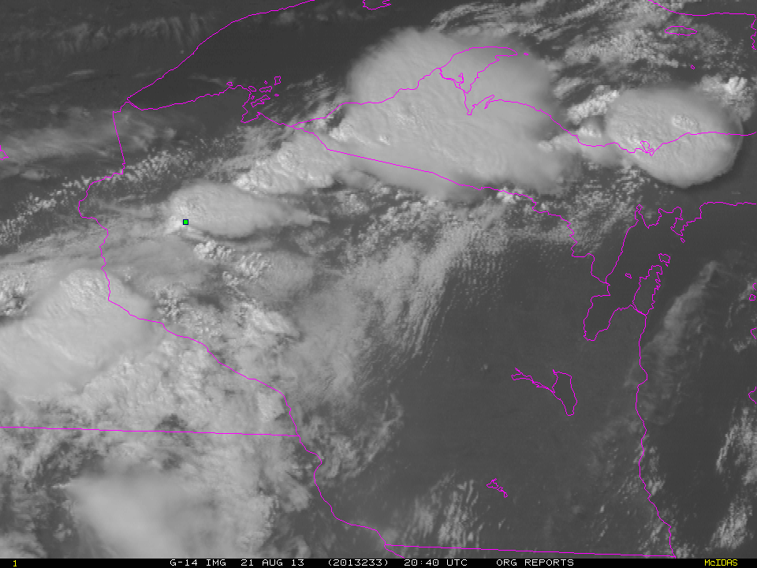

GOES-14, original storm report
GOES-14, parallax corrected (12km) storm report
Notes:
Image shifted using Bob K. codes… Here's an example how the storm report shifts relative to storm structure in a native projection and in a parallax-corrected storm report.
Parallax correction uses infrared imagery because the correction is a function of height derived from IR temperatures…those corrections are then applied to the higher spatial-resolution visible imagery.

Slide 26
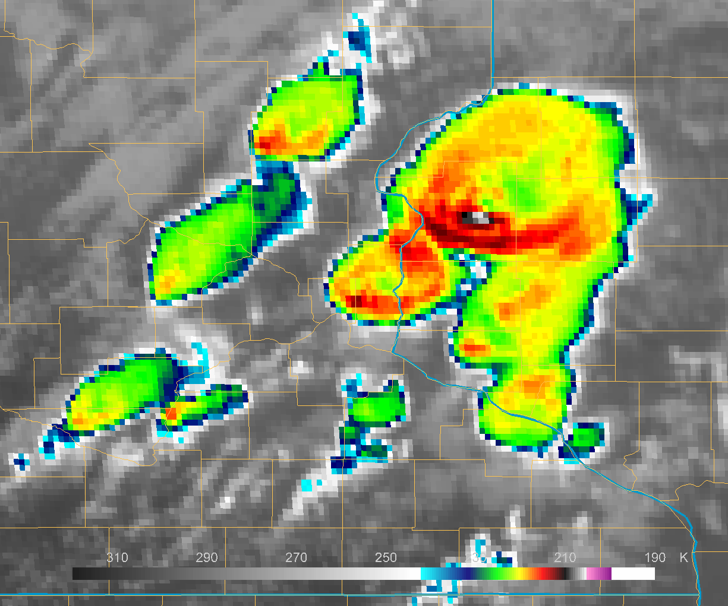
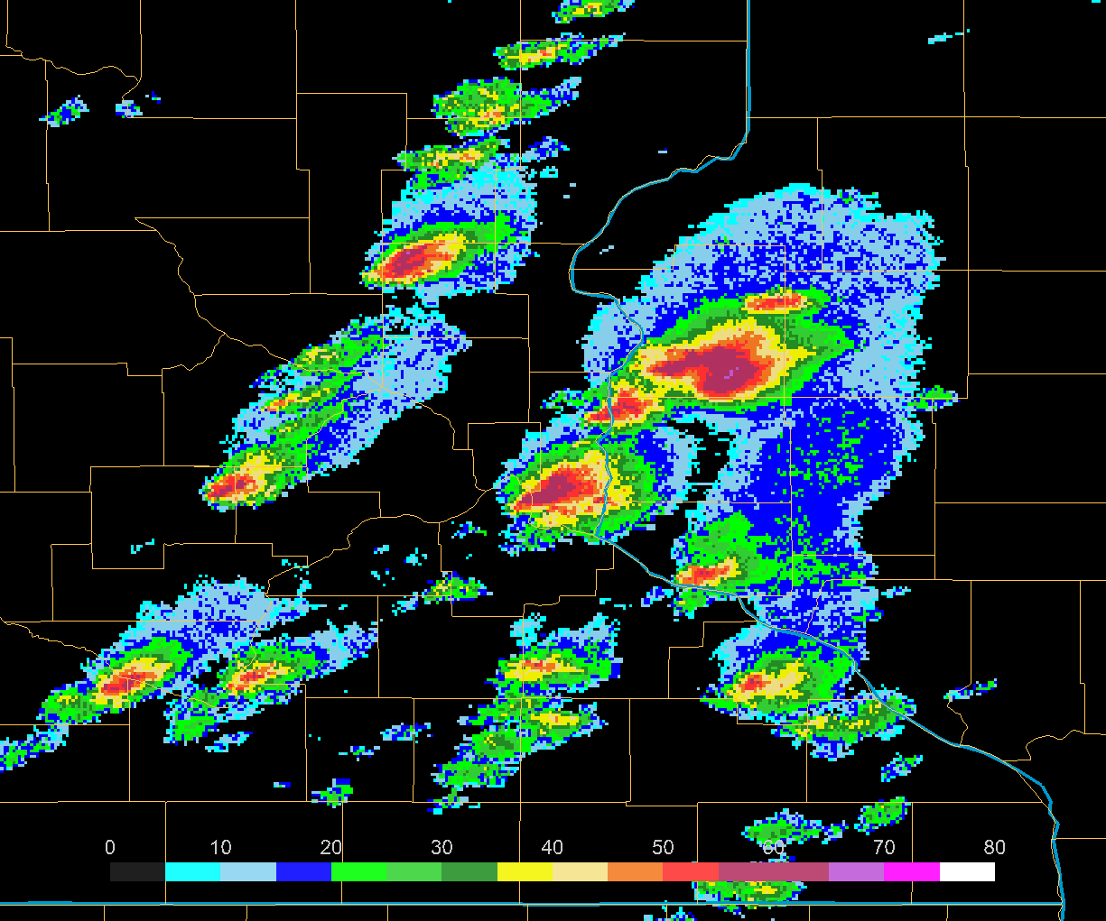
ABI in Test Position
MRMS Radar
Notes:
This shows GOES-16 ABI and MRMS Radar views of storms in Minnesota and Wisconsin when GOES-16 was in the test position at 89.5. A Parallax shift is obvious: Satellite information is shifted away from the sub-satellite point, in this case almost due south of these storms. If this were ABI from the GOES-East position, the parallax shift would have the storm farther to the northwest.
Parallax is a function of storm height and location with respect to the sub-satellite point. For any given WFO and satellite, the parallax shift will always be in the same direction. No routine parallax correction is applied to ABI data in AWIPS.

Slide 27
GOES-R Imagery Bit Depths
Bit depth establishes the precision of the data. The higher the bit depth, the higher the precision.
Heritage imagery was transmitted and displayed in AWIPS (and elsewhere) with eight bits (2⁸ = 256 discrete values).
GOES-R imagery is between 11 and 14 bits:
  11 bits (2,048 discrete values)
    Bands 1 through 6 (0.0006), 8 and 9, and 16 (0.04)
  12 bits (4,096 discrete values)
    Bands 10 through 15 (0.04)
  14 bits (16,384 discrete values)
    Band 7 (for fires, greater range)
Notes:
Let's talk now about bit depth. GOES-R sends many more bits of information than legacy GOES did. In general, legacy GOES had 8 bits of information at each pixel (256 different values). GOES-R sends 11-14 bits, depending on the band. That means higher precision in the measurements.

Slide 28
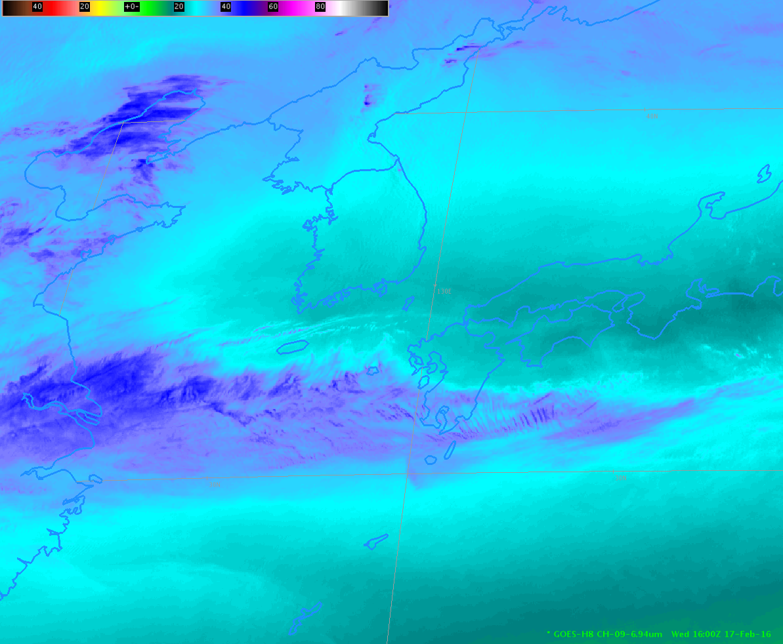
Bit Depth Matters – this is 8-bit
Notes:
AWIPS can display 11-bit, 12-bit and 14-bit enhancements, and your eye can discern differences between 8-bit and 11-bit enhancements. This is an 8-bit display. the next slide will show 11-bit imagery.

Slide 29

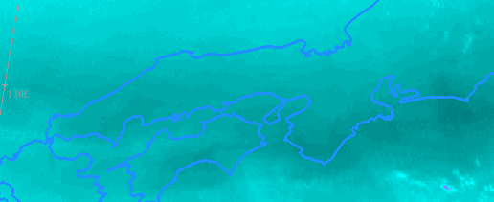

This is the 11-bit representation of the image
8-bit presentation
11-bit presentation
8-bit presentation
11-bit presentation
Notes:
The 11-bit presentation show subtly smoother gradients. 8-bit presentations from the previous slide have been cut out and are displayed near their 11-bit counterparts.

Slide 30
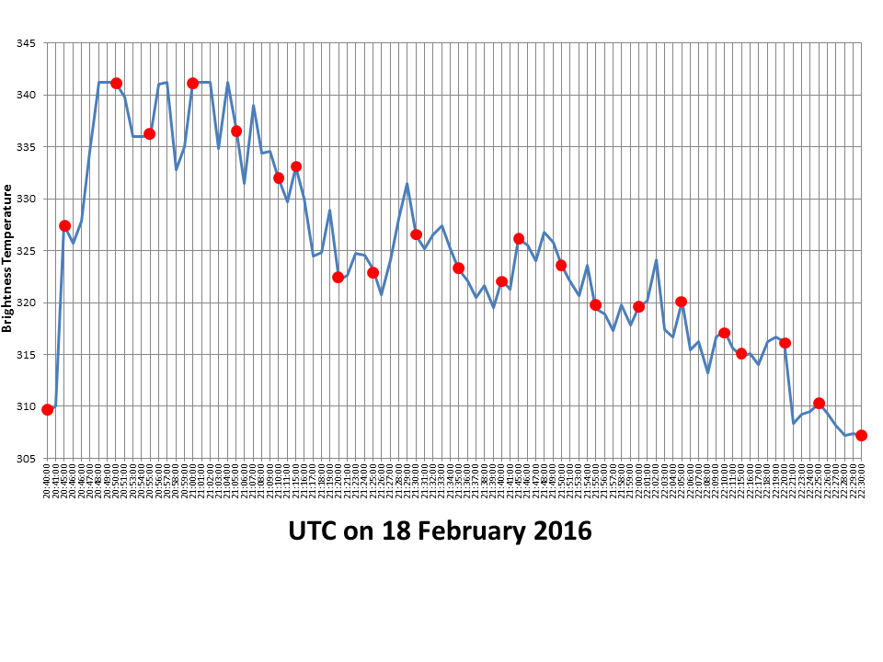
One-minute Imagery
Fast temporal sampling better resolves phenomena
  Fires (http://cimss.ssec.wisc.edu/goes/blog/archives/20756)
  Orphan Anvils (http://cimss.ssec.wisc.edu/goes/blog/archives/18696)
  Beavertails (http://cimss.ssec.wisc.edu/goes/blog/archives/18709)
  Low Clouds (http://cimss.ssec.wisc.edu/goes/blog/archives/20694)
  Fog Dissipation (http://cimss.ssec.wisc.edu/goes/blog/archives/16461)
Notes:
The importance of 1-minute sampling is well known. GOES-R offers mesoscale sectors with 1-minute sampling so that better monitoring of cloud-top features, or fires (for example) are possible. Examples are available at the urls listed. In addition, the figure insert shows brightness temperatures for the Buffalo OK fire of 18 February at 1-minute increments. The red dots show how the fast-changing fire would be sampled at 5-minute increments. Many quick changes are missed with a 5-minute sampling frequency.

Slide 31
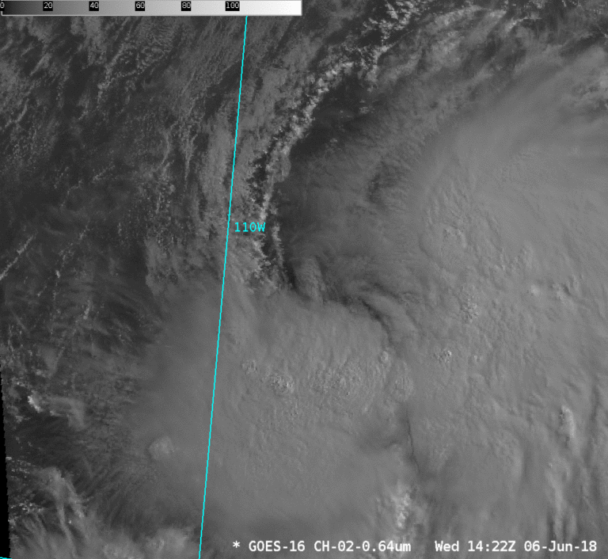
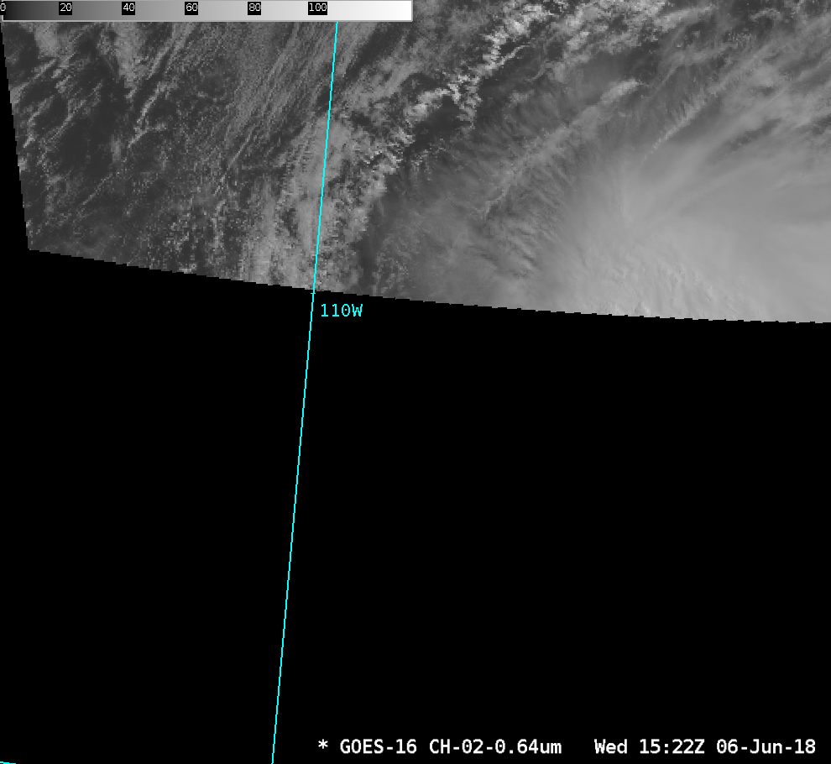
Mesoscale Sectors
These are moveable!! Tropical Storm Aletta in the Pacific formed south of the CONUS sector. You could get 15-minute Full Disk data, but the smooth evolution of the storm is far better resolved by 1-minute data.
GOES-East CONUS cuts off at 15 N
Notes:
An important part of Mesoscale Sectors on GOES-R is that They can move. If something -- the figure shows Tropical Storm Aletta in the Pacific Ocean -- occurs outside of routine CONUS 5-minute scanning, put a meso on top of it to see what's happening with better temporal scanning.

Slide 32
What does GOES-R + GOES-Heritage mean for Spatial Resolution?
If there are two satellites with two separate horizontal resolutions,
where is the resolution the best over CONUS from either satellite?
(Separate question: What to do with the differences in temporal resolution!)
Notes:
GOES-15 is still operational as GOES-West as this module is made. Where does GOES-16 give better resolution? In the near future, when two GOES-R satellites are operational as East and West, which satellite should you use?

Slide 33
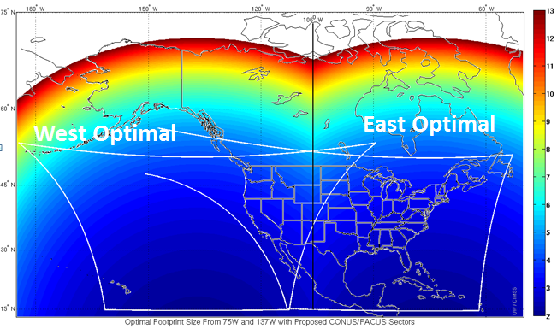
ABI IR Pixel size from West and East
(ABI CONUS West and East)
Both GOES-R Series!
106 W
East of 106 W: GOES-East
West of 106 W: GOES-West
What satellite gives the best resolution?
Notes:
To answer the 2nd question first: In an all-GOES-R constellation, GOES-East sits over 75.2 W, and GOES-West sits over 137 W. Halfway between is about 106 W, so you might want to use GOES-East to the east of that longitude and GOES-West to the west of it. 106 W is near Glasgow MT and Albuquerque NM.

Slide 34
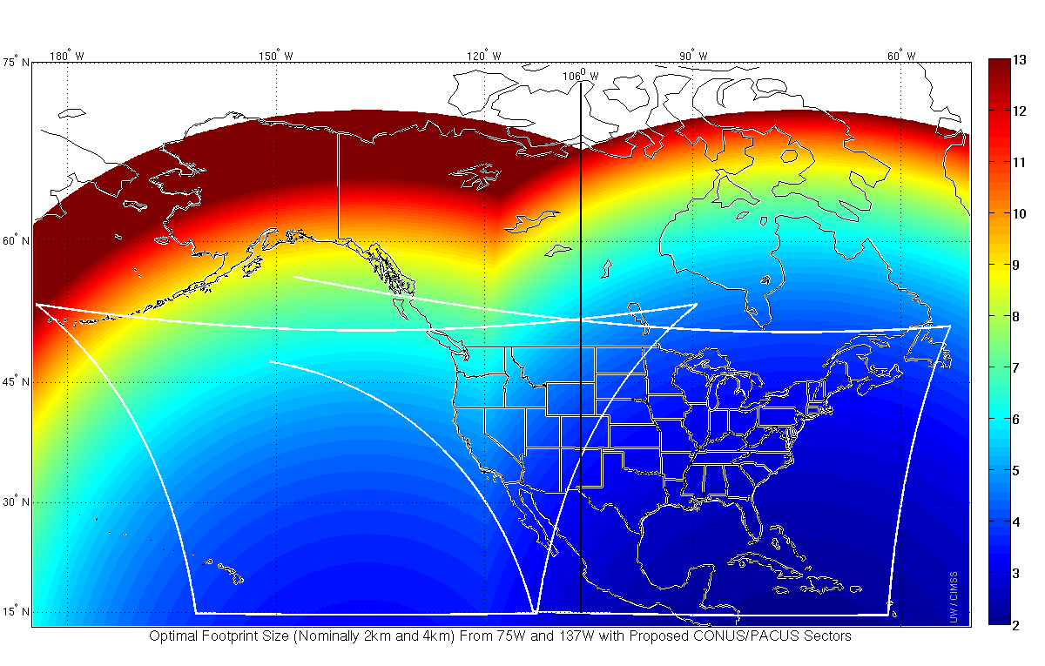
2017-2018 Reality GOES-16 as GOES East/ GOES-15 as GOES-West
Infrared Resolution color coded
120 W
Image Source: Jun Li/Mat Gunshor
Notes:
The reality after GOES-16 became GOES-East (and GOES-15 was operational as GOES-West) was that GOES-East had superior spatial resolution all the way to 120 W - that's the longiude of the The north-south California / Nevada border). In practice, many west-coast WFOs defaulted to GOES-16 because of the superior temporal and spectral resolution. In addition, GOES-16 data flows more rapidly into AWIPS than GOES-15.

Slide 35
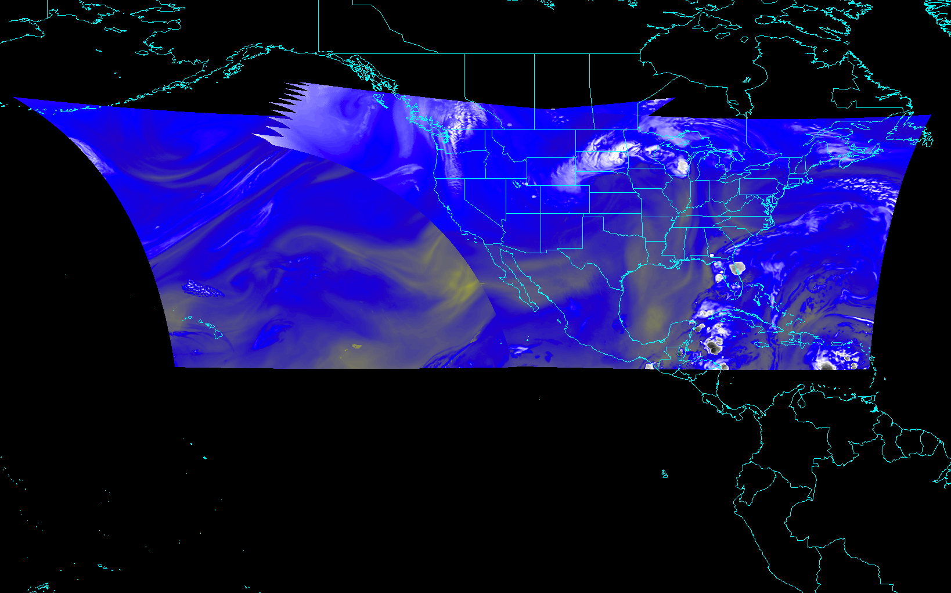
CONUS from East and West
Every 5 minutes!
Notes:
this shows the GOES-R satellites GOES-East and GOES-West combined and their two CONUS projections, both scanned every 5-minutes, and offering coverage from the Aleutians to the eastern Caribbean and from Hawaii to the Canadian Maritimes.

Slide 36
Acronyms from this training
CONUS: Contiguous United States
GOES-R: http://www.goes-r.gov/
GOES: Geostationary Operational Environmental Satellite
STOR: Satellite Training and Operations Resource, a handy training page on NOAA’s Vlab (link)

Slide 37
  Scan strategy and temporal refresh; Bands overview; Spatial resolution; Parallax; Bit depth; Operation of GOES-R and legacy GOES simultaneously
The ABI : a game-changing instrument, scanning more wavelengths faster and with better spatial resolution
ABI Data Volume
Legacy GOES Data Volume
3X
More spectral bands (16 on ABI vs. 5 on current imager)
5X
Faster coverage
(5-minute full disk vs. 25-minute)
4X
Improved spatial
resolution
(2 km IR vs. 4 km)
GOES-R sends around 1 terabyte of data daily!! ~60-fold increase
Notes:
Slide from J. Gerth, CIMSS. This is a summary to remind you what you've just learned. This is the conclusion of the Satellite Foundational Course for GOES_R on Basic Operations of the ABI on GOES_R. Thanks for your attention.

