Slide 1
c
William Straka - Presenter
With thanks to Jen Delamere, Sean Helfrich, the LEO Program and Many others!

Slide 2
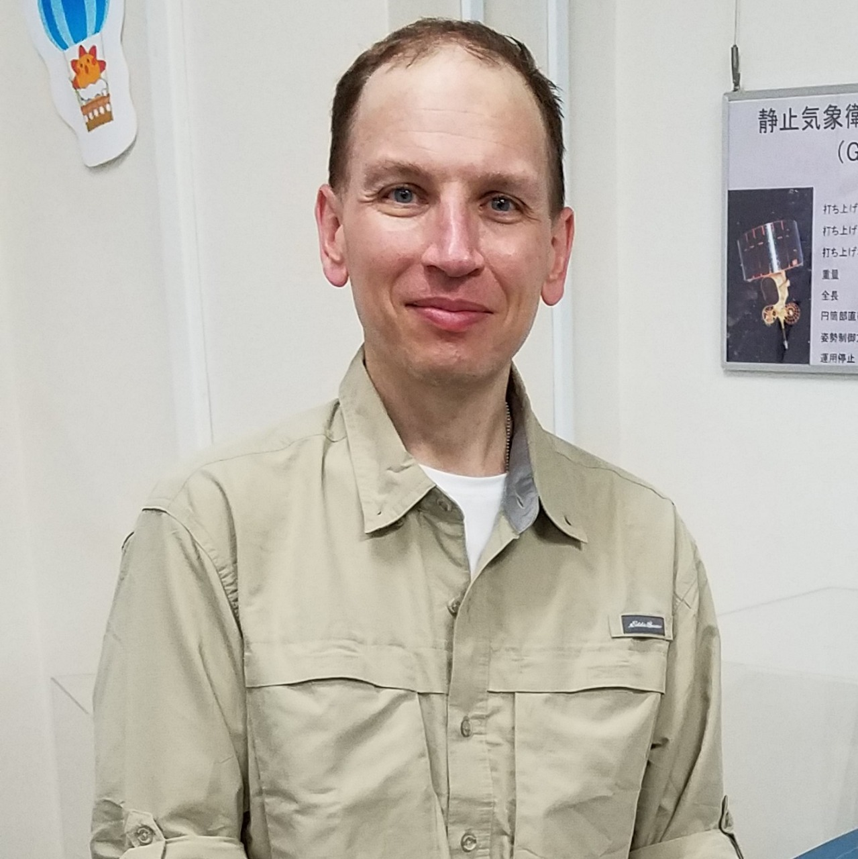
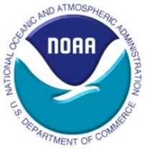
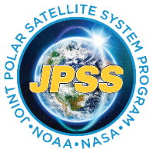
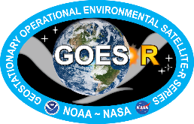
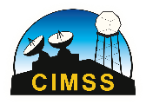
Acknowledgements: Sanmei Li (GMU), Mitch Goldberg (CCNY/CESSRST, former NOAA NESDIS Chief Scientist), as well as many others
Presenter BIO:
William Straka is a researcher with the Cooperative Institute for Meteorological Satellite Studies (CIMSS), where he has been working for over 18 years. He currently works as a liaison, including assisting in training, to the US National Weather Service as well as US and international emergency response stakeholders such as BMKG on the NOAA Flood Products.
William Straka III
wstraka@ssec.wisc.edu
william.straka@noaa.gov
Notes:
What you do know about satellite-derived flood products"; "How many flood products do you know, could you mention them", or "Do you have experience with it?"; "What is the actual output of VIR products?" etc... (we can do this with Slido or even as simple as asking the participants to type the answer in the chat column). After gaining their answer, slide 1 to 3 can be explained.

Slide 3
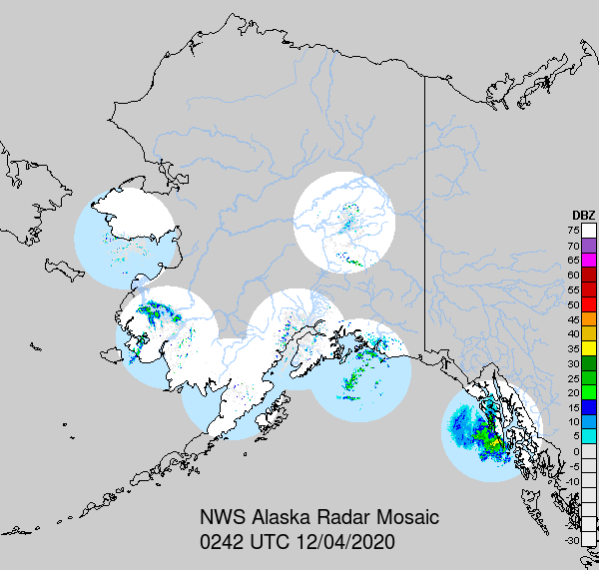
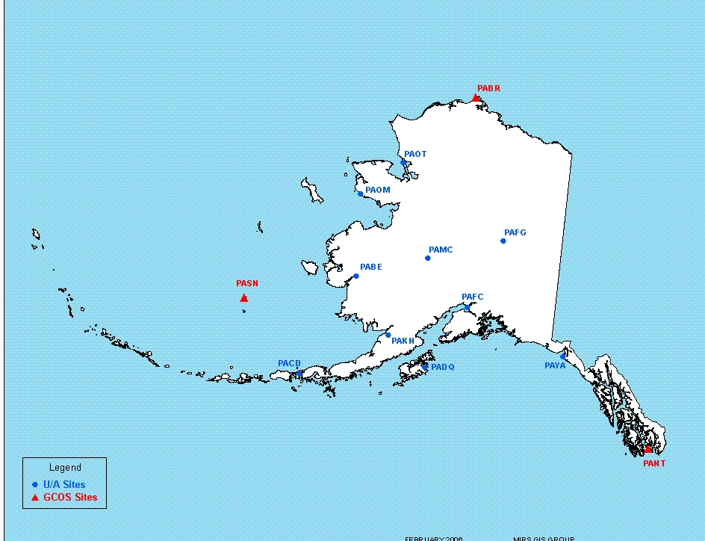
Data Coverage in Alaska is Limited
7 Radars in AK
13 U/A Stations
Notes:
Unlike the the CONUS which has over 140 radars and many U/A stations, Alaska has only 7 radars and 13 U/A stations for an area near ¼ of the CONUS. Nearly all Alaskan radars have beam blockage due to terrain. In SE Alaska the one radar on Biorka Island can only view offshore and the adjacent coast.

Slide 4
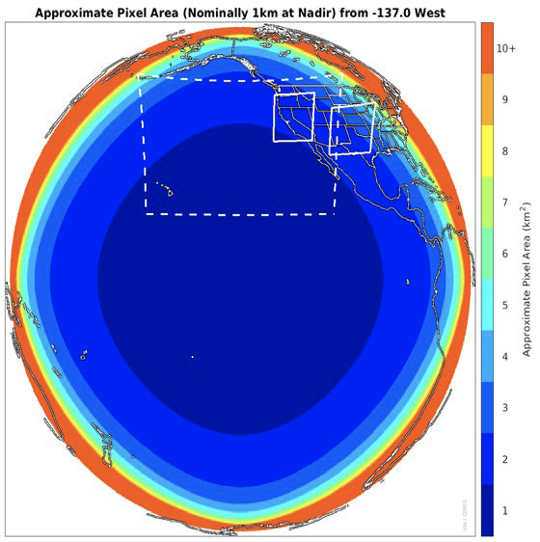
Geostationary data has a lot of limitations

Slide 5
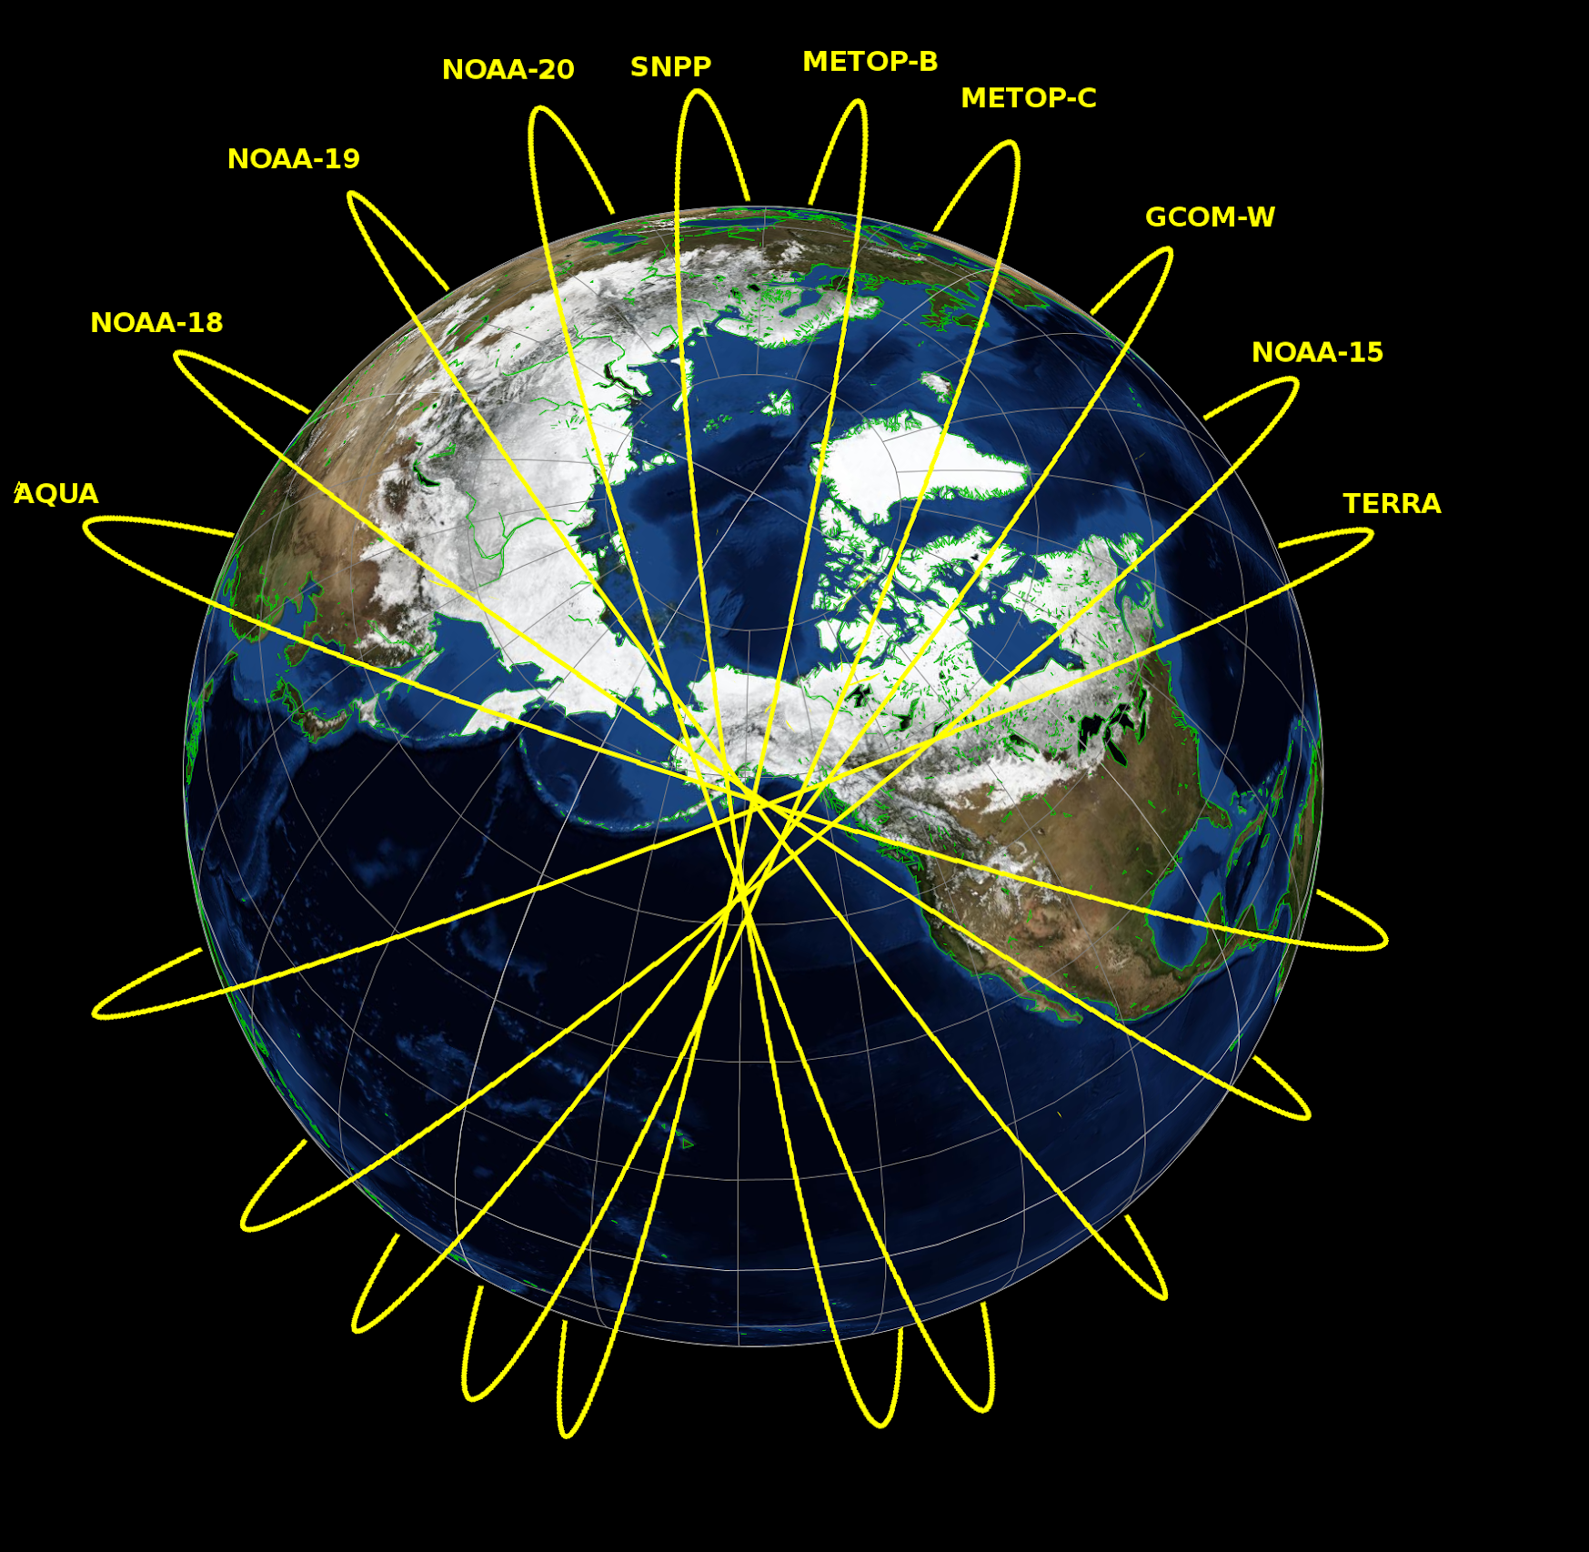
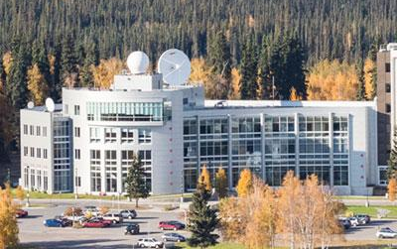
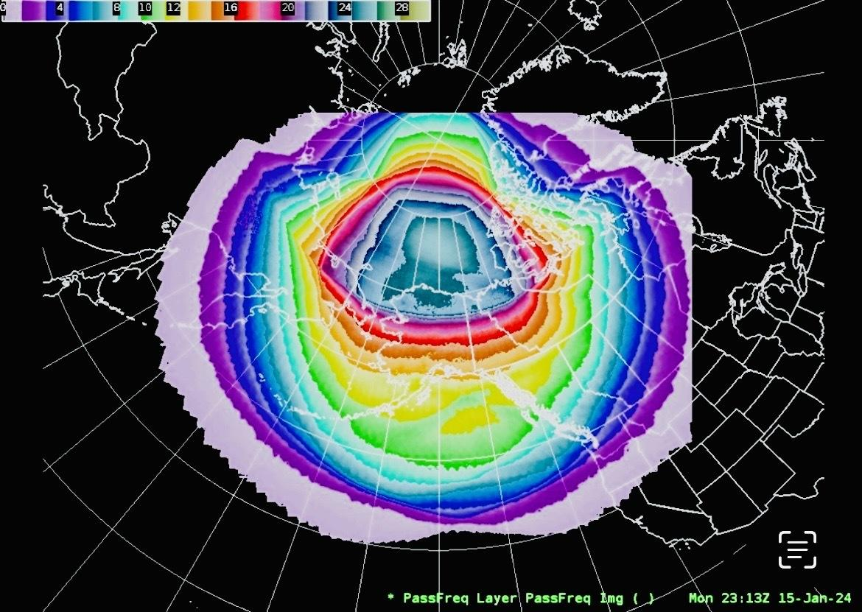
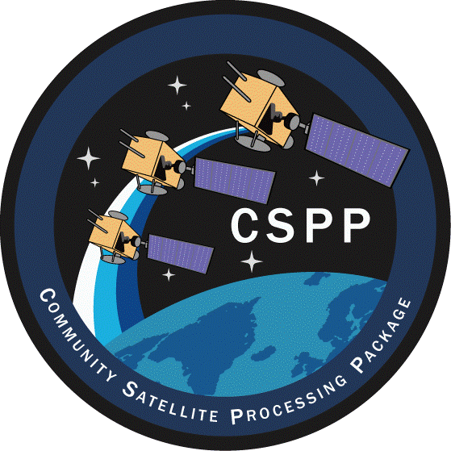
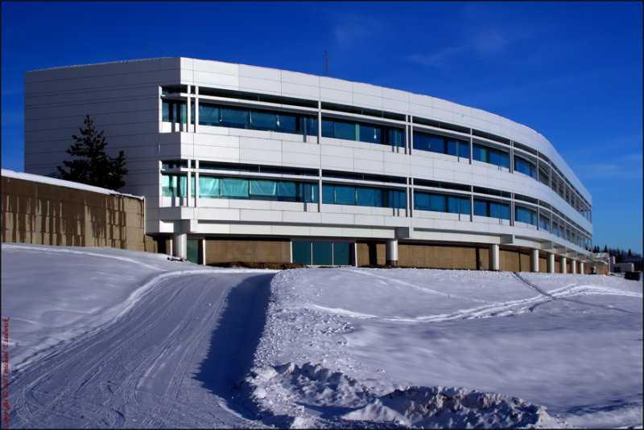
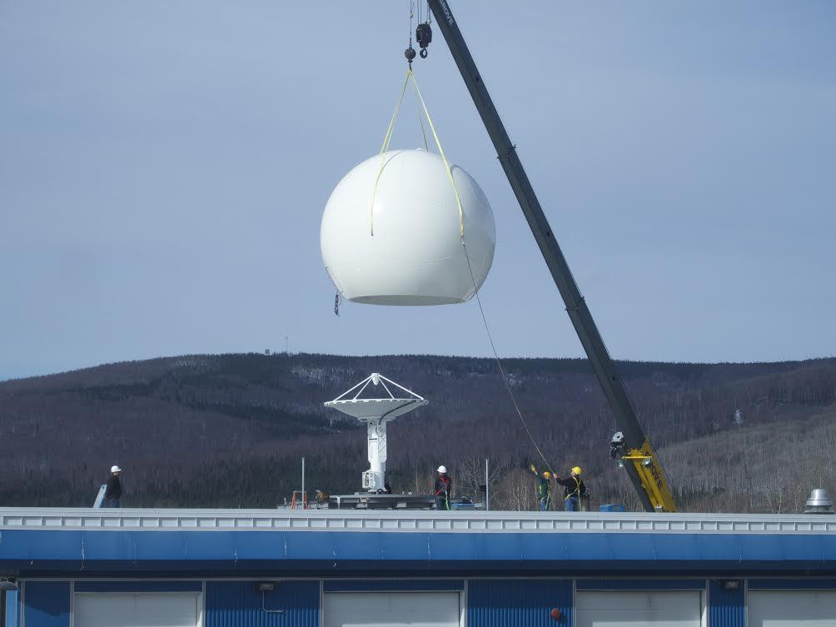
Where we are now
UAF-GINA & NESDIS Facilities
Near real-time
processing stacks in Alaska delivering products worldwide
within 15 minutes
of a LEO overpass
3 JPSS Satellites
VIIRS Sensor Coverage
24+ views of the Arctic
16+ views of Interior AK
GINA: Keeping Data Close to the Customers

Slide 6
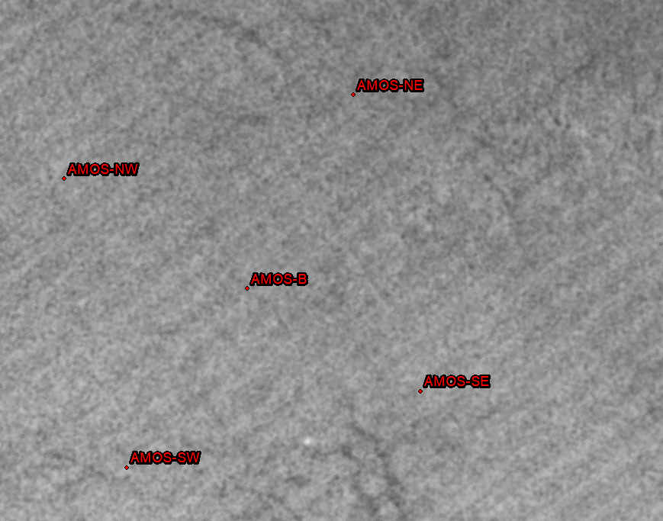
November 6, 2023 Sikuliaq Ice Support
Animation of Day Night Band between 10Z and 21Z today from NOAA-20, NOAA-21, and S-NPP show several possible lead targets to aim for
Of note, Sikuliaq lights show overnight exploiting existing leads

Slide 7
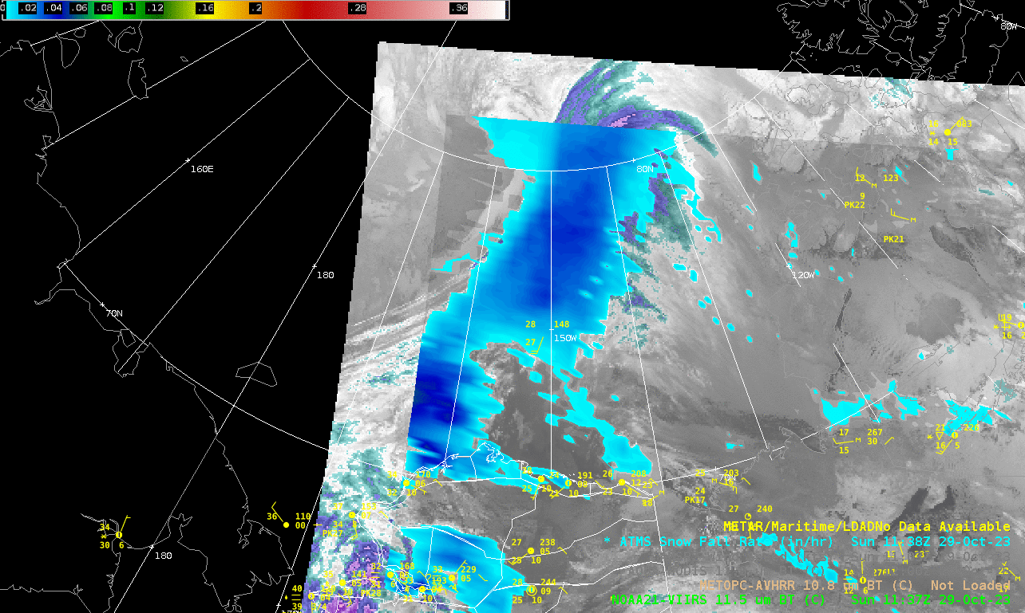
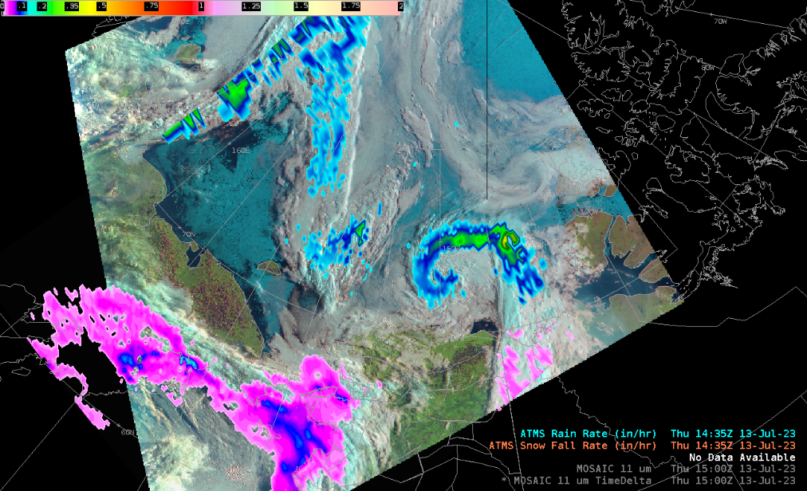
Microwave Sensors: Alaska Snowfall Rate & MiRS
JPSS, MetOp, NOAA-POES
NOAA-STAR, NOAA Climate Prediction Center, NWS WFOs,
Accessible via AWIPS
Deployed on GINA Computers; Delivered to AWIPS
AK-SFR & VIIRS i05 (11.5 µm) – 29 Oct 2023
AK-SFR/MIRS RainRate/DLC RGB – 17 Jul 2023
IPOPP Software

Slide 8
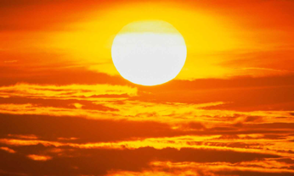
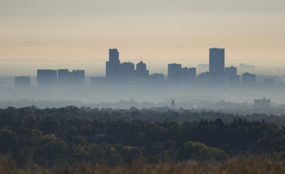
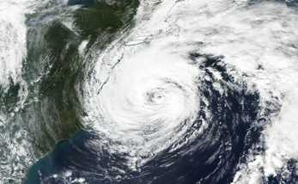
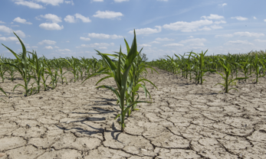
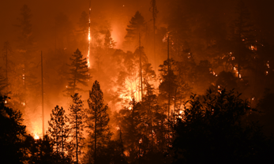
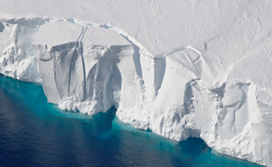
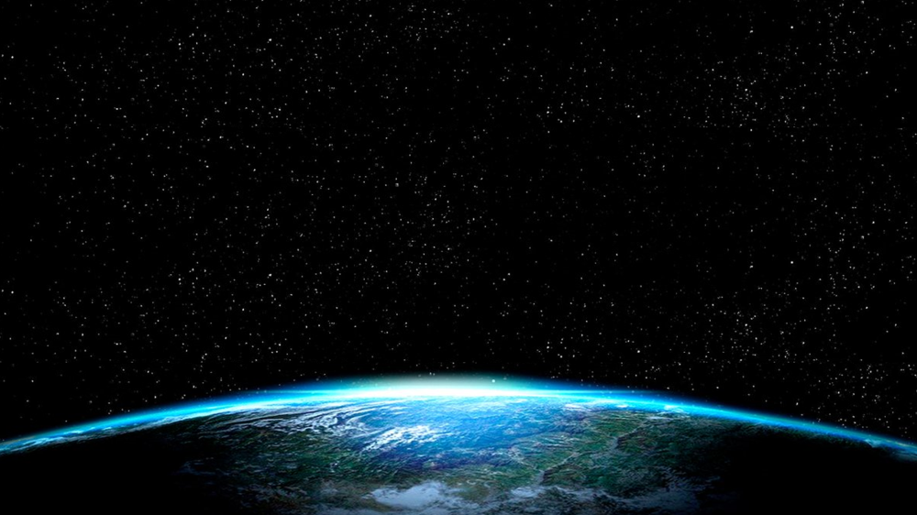
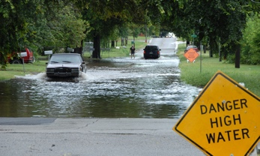
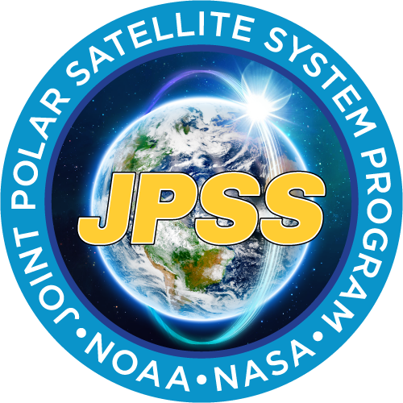
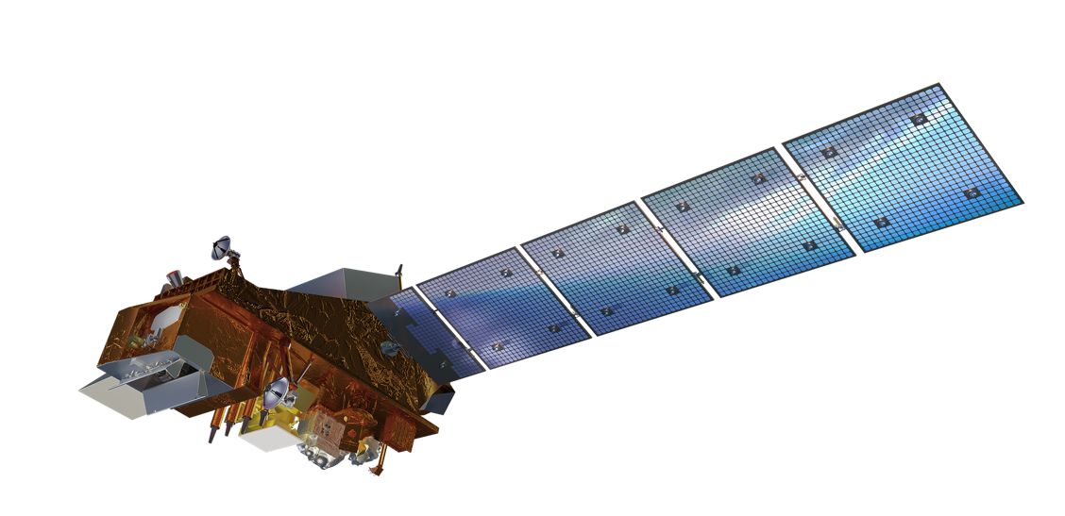
LEO Environmental Observations
Earth Science Products & Applications for:
Weather forecasting
Disaster management, and
Understanding effects of global climate change.
NOAA-21 launched November 10, 2022
Notes:
LEO environmental observations
Provide a comprehensive set of global Earth observations
Contribute to the largest number of Earth science products and applications
Essential for:
weather forecasting
disaster management (fires, floods, etc.), and
understanding the effects of global climate change.
LEO satellites have the largest impact on Numerical Weather Prediction (NWP) models, ocean remote sensing and atmospheric composition

Slide 9
LEO Observational Needs
LEO environmental observations are:
Essential to national needs in diverse areas including weather forecasting, disaster management (fires, floods, etc.), and understanding the effects of global climate change.
Provide a comprehensive set of global Earth observations
Contribute to the largest number of Earth science products and applications
LEO satellites have the largest impact on Numerical Weather Prediction (NWP) models, ocean remote sensing and atmospheric composition
Over 40 years of LEO observations provide critical information about climate and global change

Slide 10
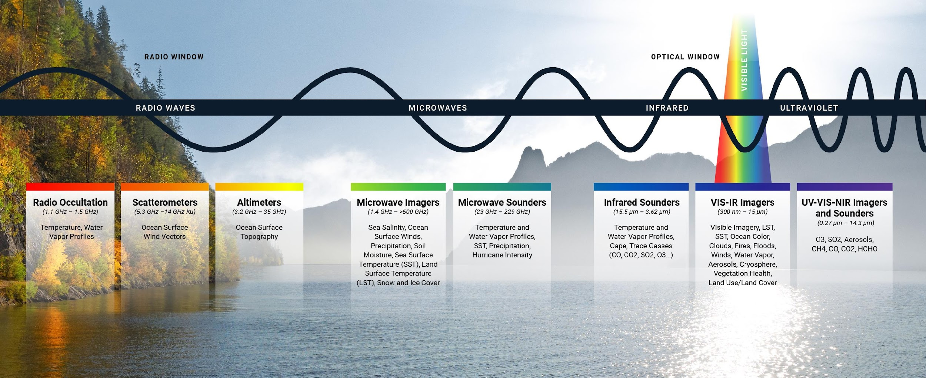
LEO Measurements Cover All Usable Regions of Electromagnetic Spectrum

Slide 12
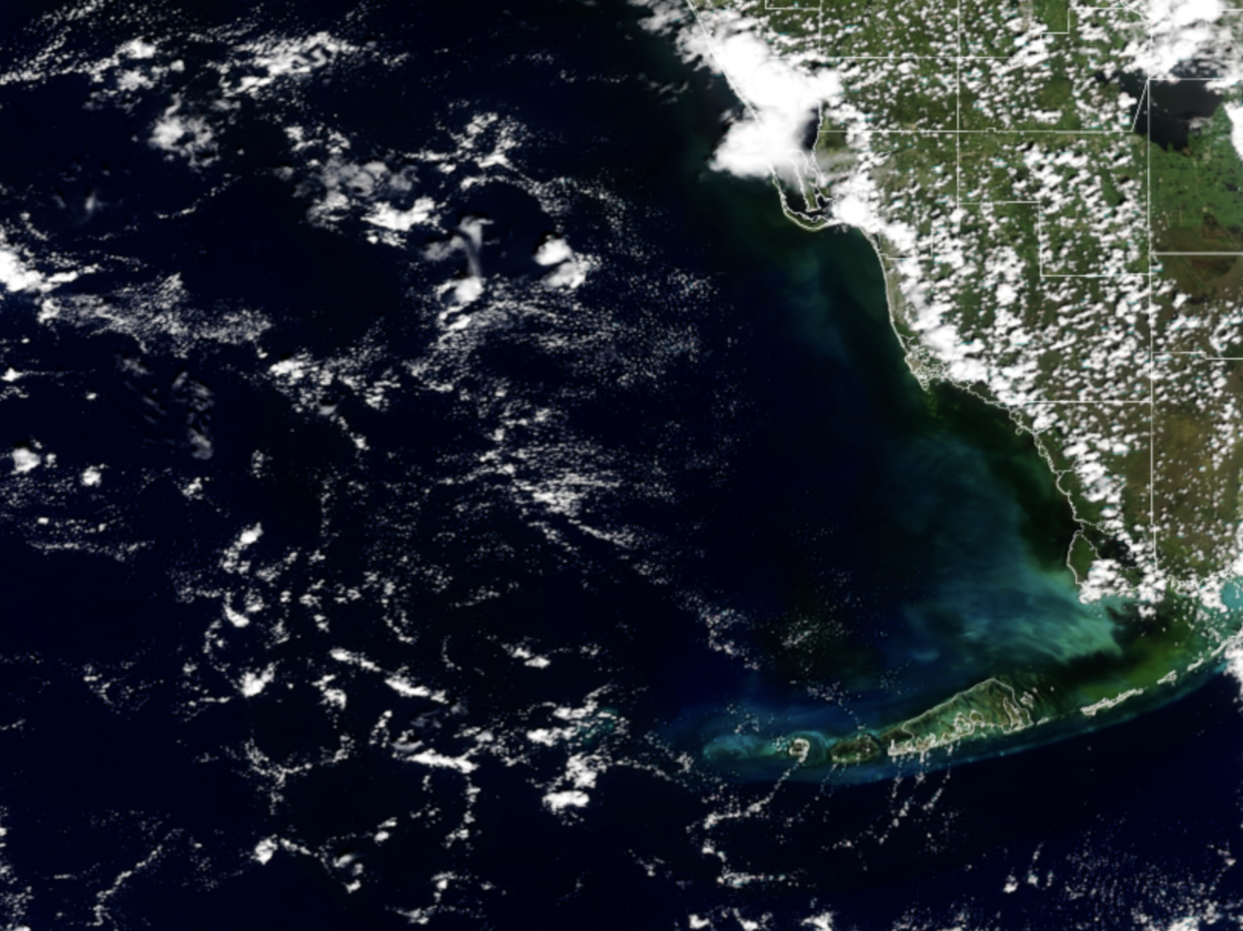
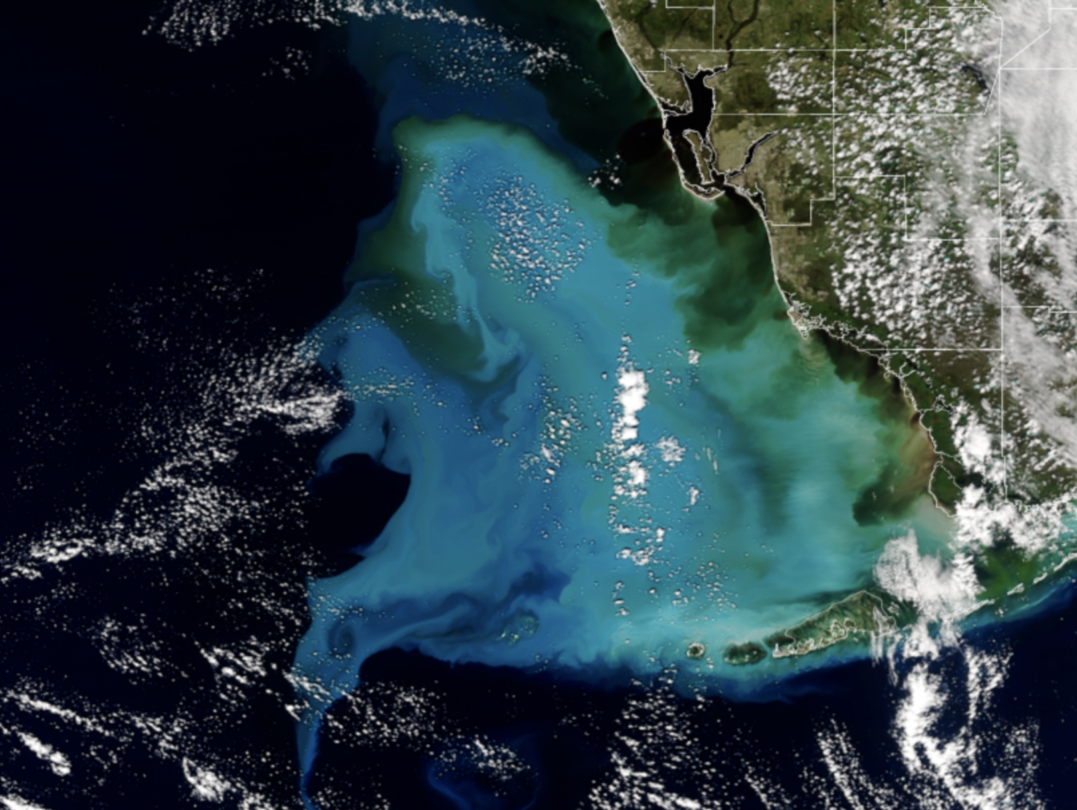
Sediment in the Gulf of Mexico after Hurricane Ian
August 28, 2021
(NOAA-20 VIIRS)
October 2, 2022
STAR JSTAR Mapper
Notes:
An example of LEO satellites in action - Disaster management
- LEO Satellites not only allow us to predict and observe the immediate impacts, but they also enable us to understand and manage the longer-term impacts.
- These images were captured using the Visible Infrared Imaging Radiometer Suite (VIIRS) instrument, which generates many critical environmental products pertaining to snow and ice cover, clouds, fog, aerosols, fire, smoke plumes, dust, vegetation health, phytoplankton abundance and chlorophyll.

Slide 13
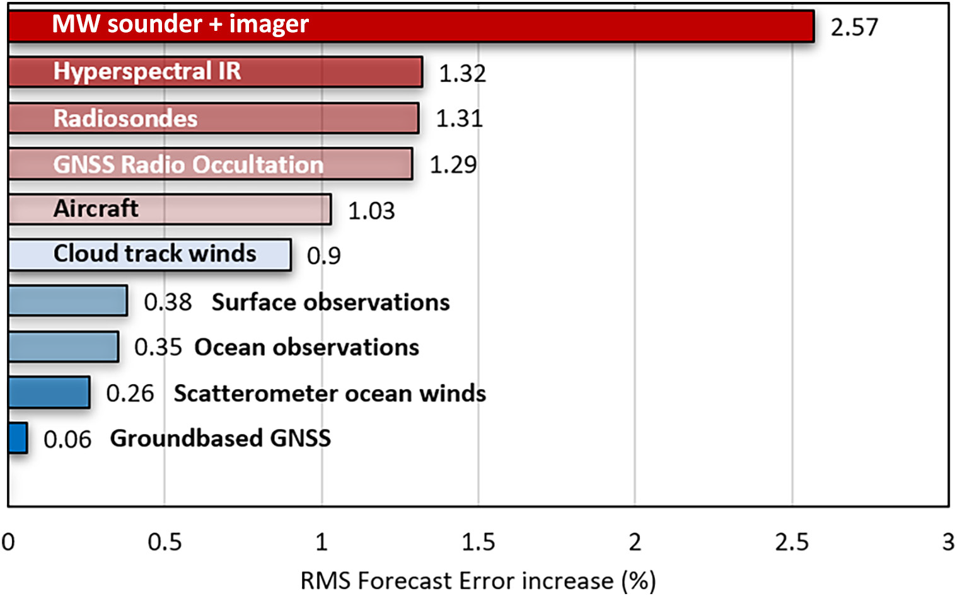
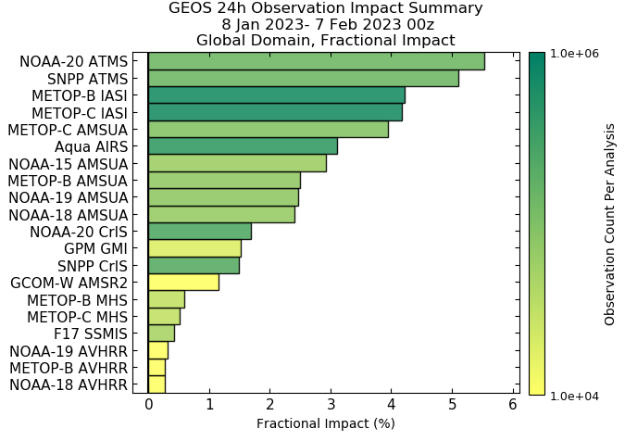
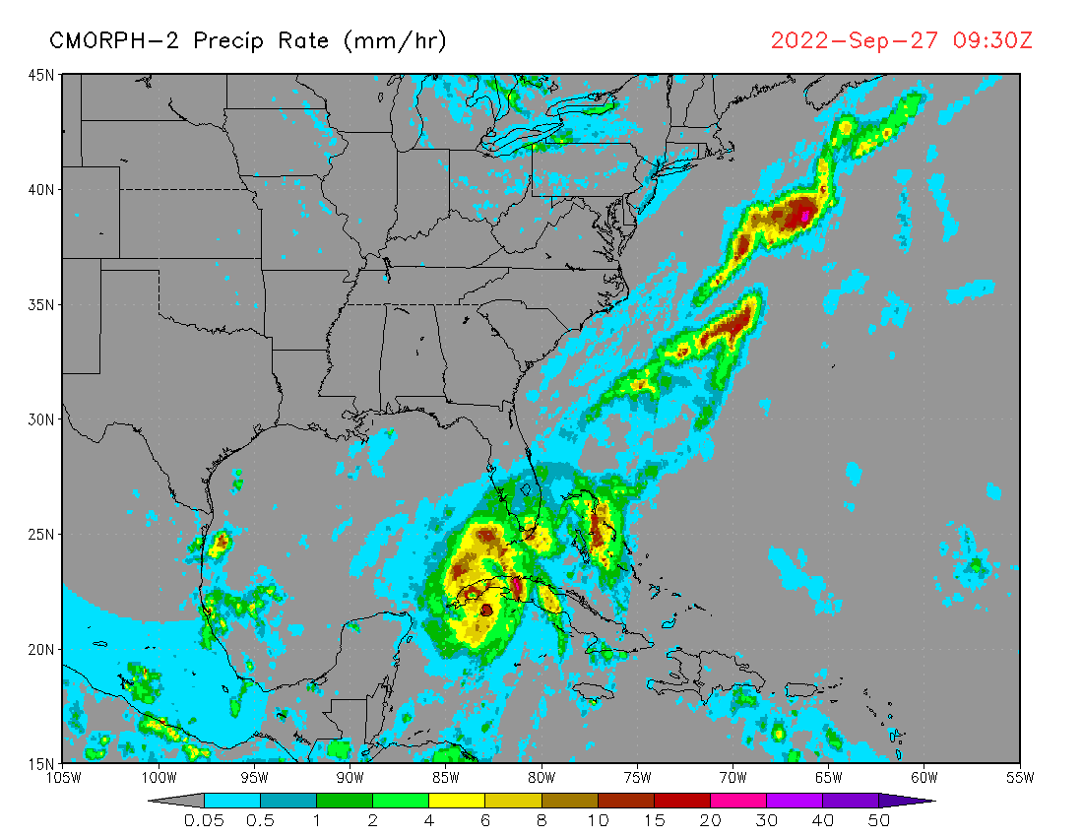
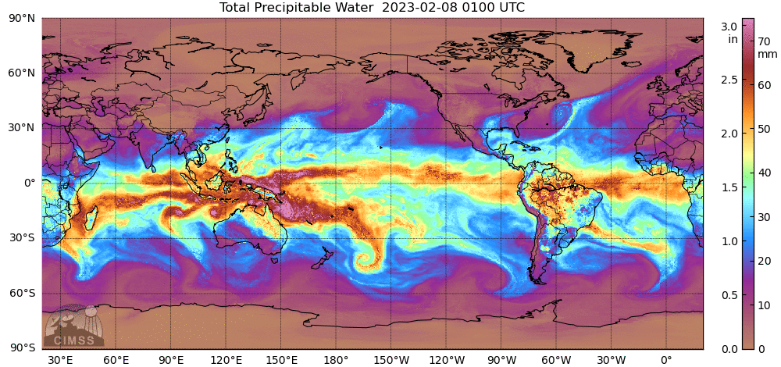
NWS Applications of LEO Observations
✓
✓ Legacy POES Still Impactful
✓
✓
LEO MW and IR measurements are the biggest contributors to skill in global Numerical Weather Prediction (NWP) models - Saunders 2021

Slide 14
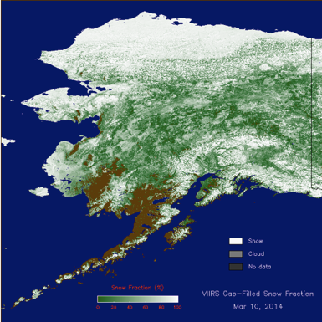
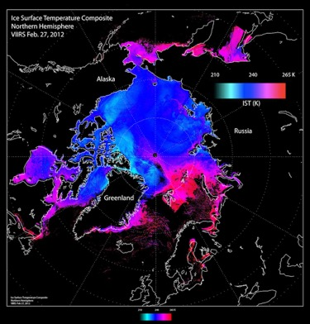
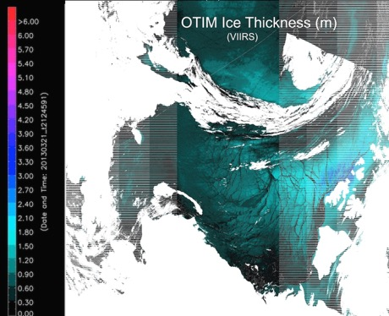
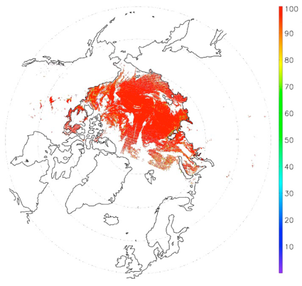
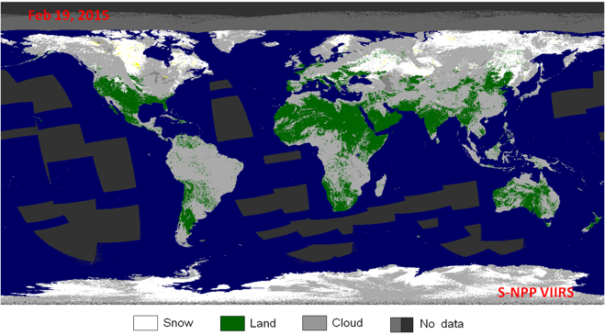
NWS Applications of LEO Observations
Snow Fraction
Ice Surface Temperature
Ice Thickness/Age
Snow Cover (binary)
Ice Concentration

Slide 15
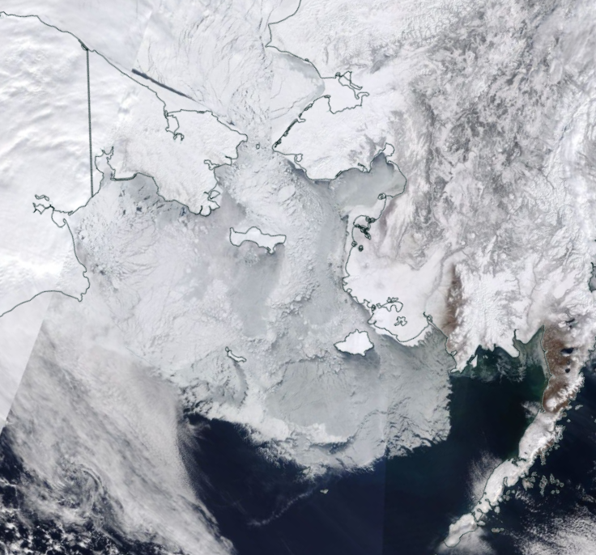
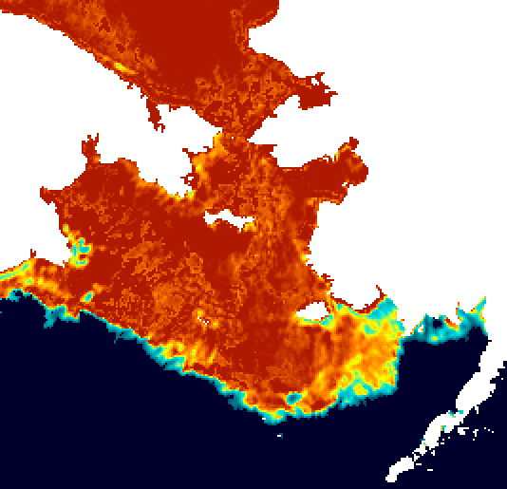
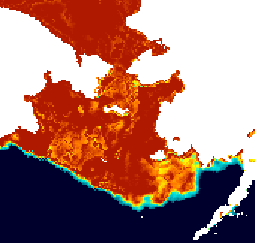
Improved Operational Sea Ice Products using Spatially Enhanced AMSR2 Data
Comparison to NOAA legacy 10 km products (Bering Sea)
22 March 2022
Legacy
MODIS
New
Lead
Bootstrap
6.25 km
NOAA NT-2
10 km
1654-1836 UTC
Fast ice
Morning
passes
Ice edge
features
Sea ice concentration (%)
Sea ice concentration (%)

Slide 16
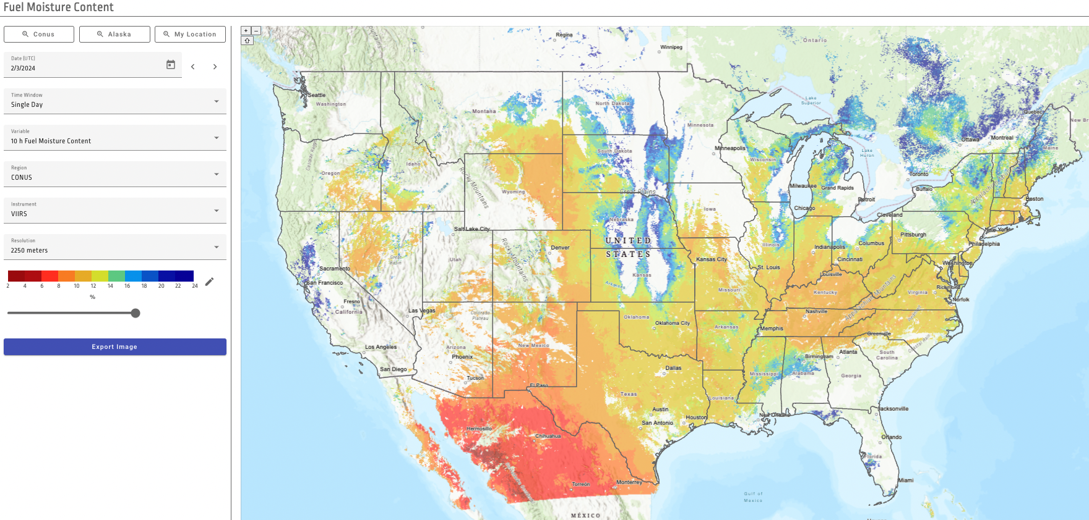
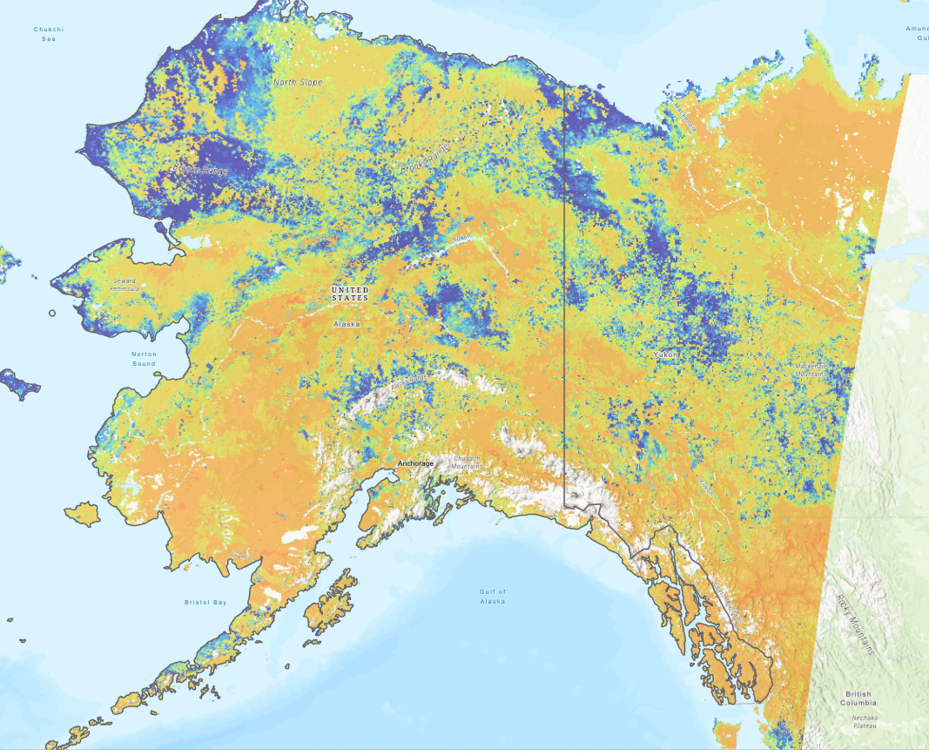
Real-time fuel moisture content (FMC) estimations at high spatio-temporal resolution based on reflectances from VIIRS and GOES-R ABI. - LEO PGRR
Started demonstration of SuomiNPP-VIIRS based retrievals on March 2023. First retrievals at 2250 m over CONUS and 3000 m over Alaska. Extended to have the target 375 m retrievals. https://ral.ucar.edu/tool/fuel-moisture-content-retrievals
Enhanced demonstration to have GOES16-ABI hourly retrievals at 2250 m (not originally planned)
Developing a visualization app (leveraging resources from other projects): https://fmc.ral.ucar.edu/
February 3 2023
30-day composite June 20 2023

Slide 17
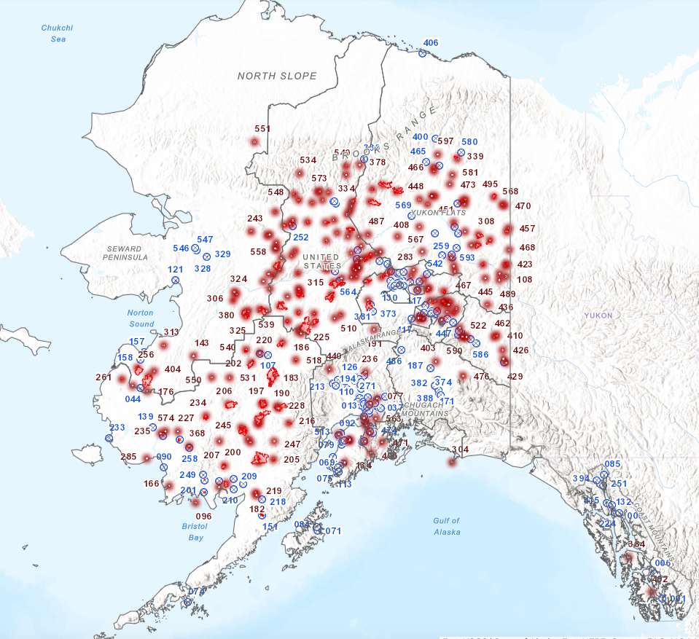

Slide 18
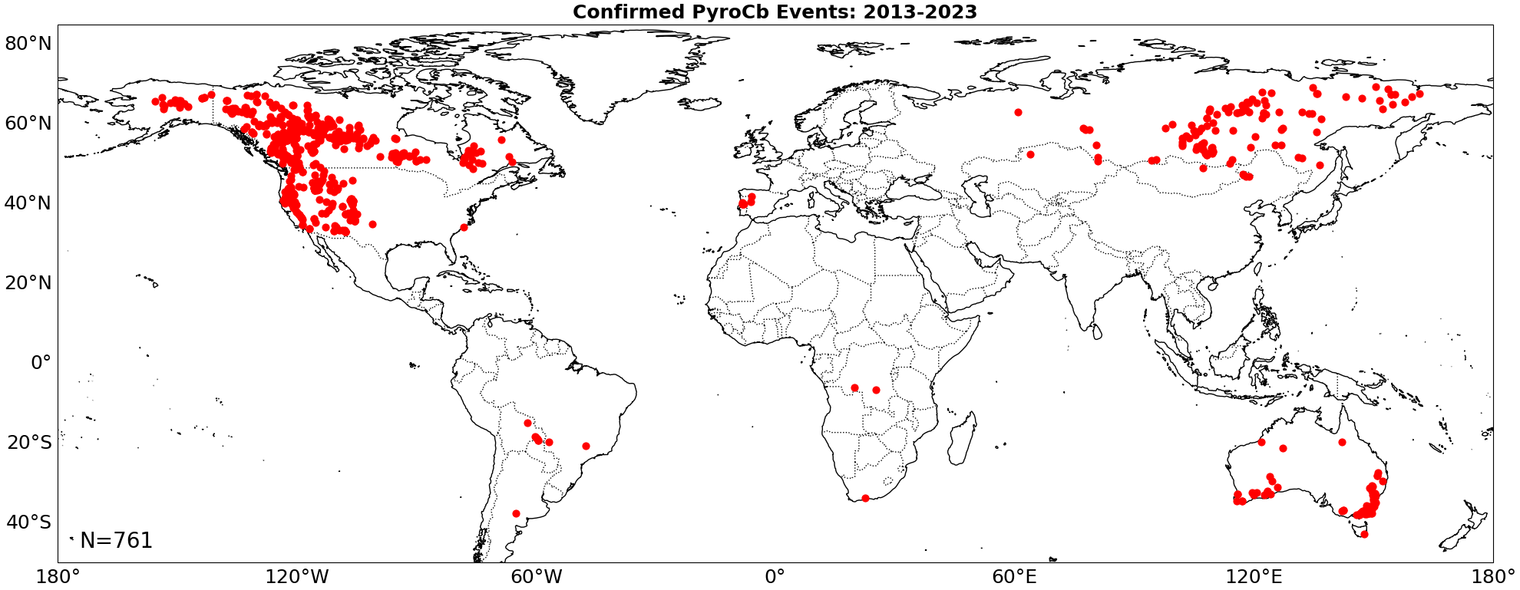
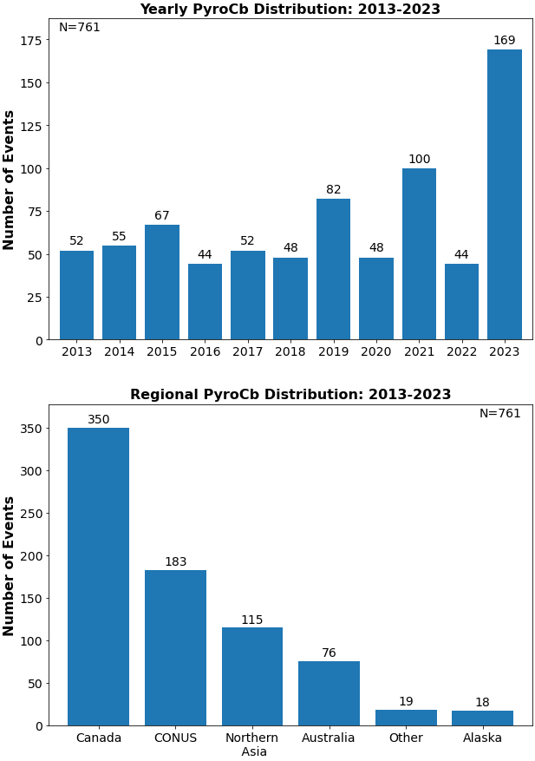
PyroCb Detection (LEO PGRR project) - NRL’s Worldwide PyroCb Inventory: Building the Training Data
Locations of 590 pyroCbs: 2013-2022
Fromm et al. 2022 (Nature Comm. Earth & Env.)
Peterson et al. (in prep)

Slide 19
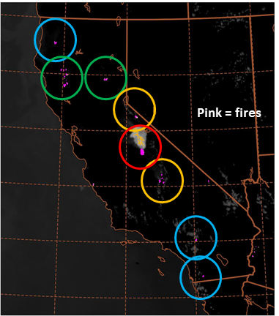
PyroCb Detection (LEO PGRR project) - PyoCb Early Warning (6-12 hr) Capability Using NUCAPS
1.
2.
3.
Fire pixel clustering algorithm
Identify individual fires
GOES ABI fire product (~2 km, 10 min.)
wildfire
cluster
NUCAPS sounding

Slide 20
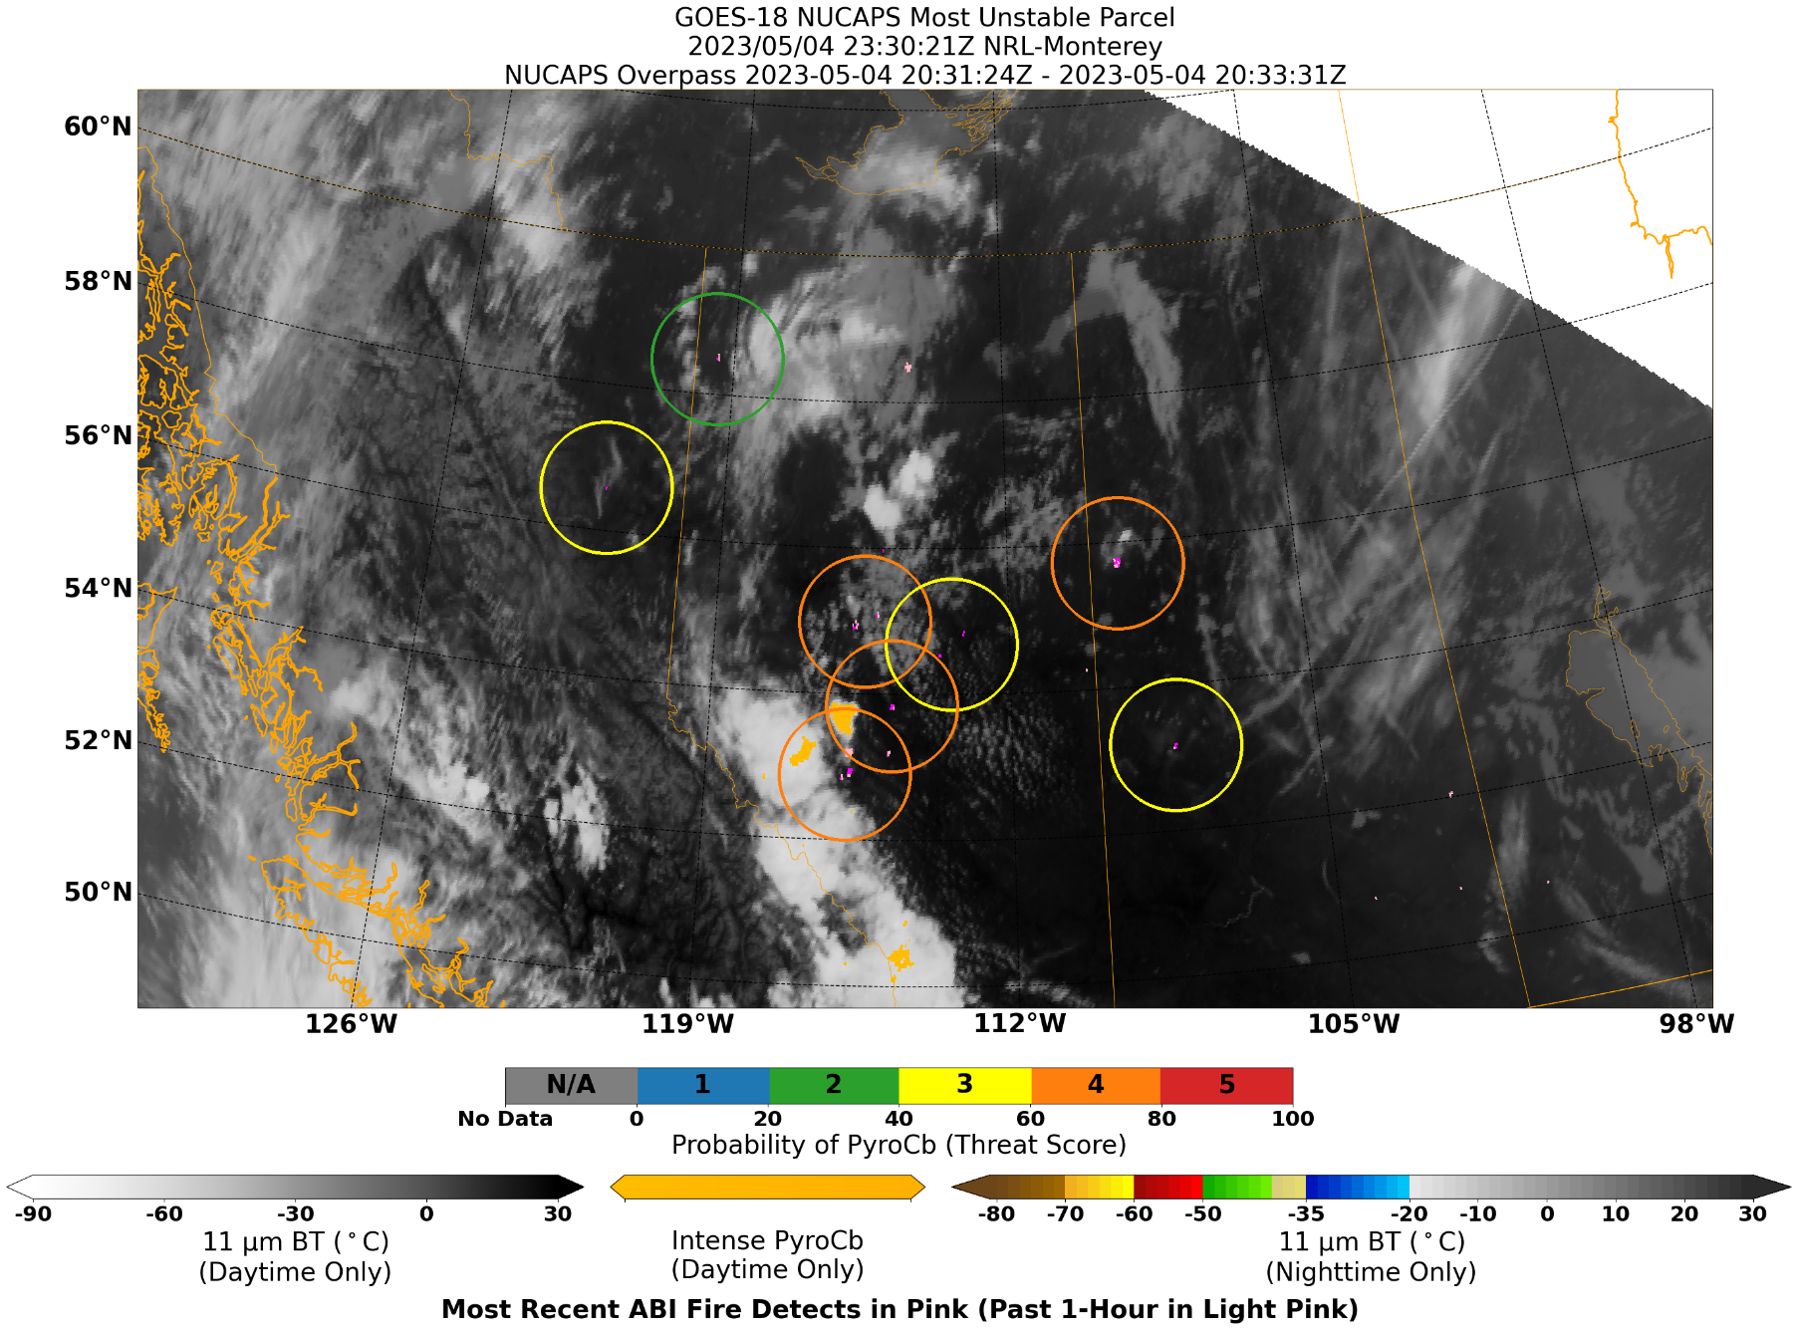
PyroCb Detection (LEO PGRR project) - Prototype demonstration

Slide 21
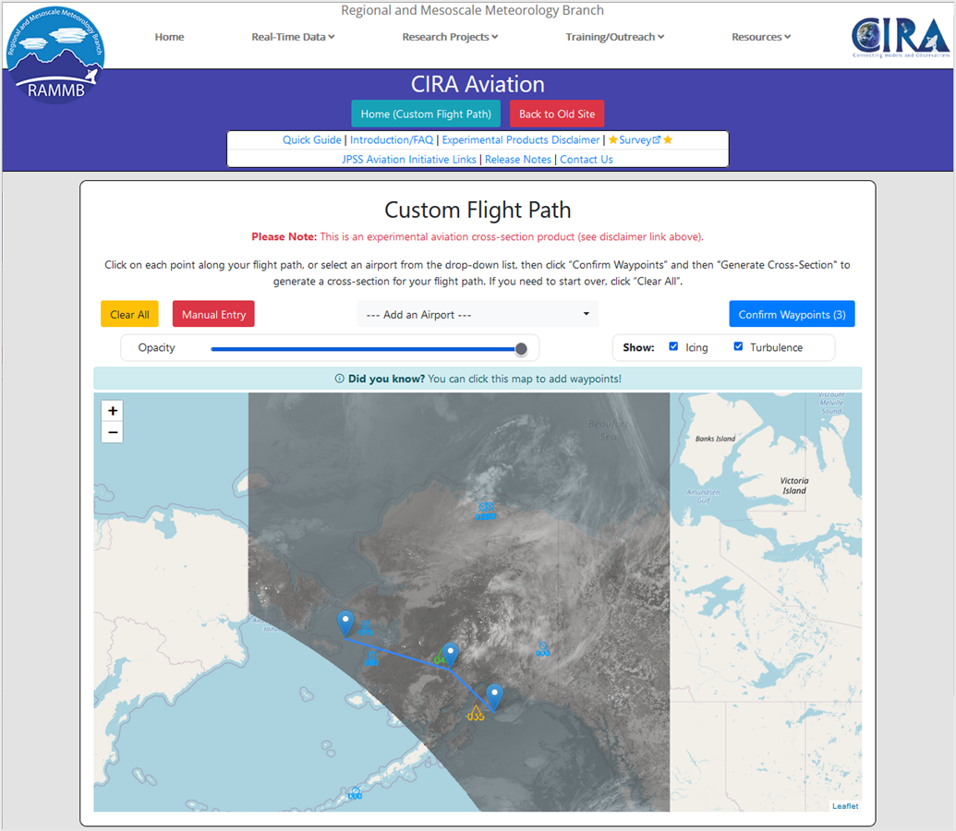
CIRA’s Aviation Website for custom cross-sections
https://aviation.cira.colostate.edu
Various user interface functions based on user feedback
User-selectable path
A layer feature for icing/turb (PIREPs)
Product evaluation/User feedback
User quick guide and documents
Extended to CONUS with ABI addition
Add smoke data (HRRR-smoke model) with smoke visibility info
Oregon Wildfire Response Protocol for Severe Smoke Episodes and Air Quality and Health guidelines by NOAA GSL

Slide 22
River ice trail monitoring??
20 Feb 2023 - 23:59 - Sentinel-1
Notes:
https://apps.sentinel-hub.com/eo-browser/?zoom=13&lat=61.28455&lng=-160.75616&themeId=DEFAULT-THEME&visualizationUrl=https%3A%2F%2Fservices.sentinel-hub.com%2Fogc%2Fwms%2Ff2068f4f-3c75-42cf-84a1-42948340a846&datasetId=S1_AWS_IW_VVVH&fromTime=2024-02-20T00%3A00%3A00.000Z&toTime=2024-02-20T23%3A59%3A59.999Z&layerId=8_RGB-RATIO&demSource3D=%22MAPZEN%22

Slide 23
And much more!!!!

Slide 24
Where are we going??

Slide 25
Near Earth Orbit Network (NEON)
“Buy or partner where we can. Build what we must.”

Slide 26
NEON Program Objectives
To provide essential space-based environmental observations that meet NESDIS’ strategic objective:
“Evolve the LEO architecture to an enterprise system of systems that exploits and deploys new observation capabilities.”
To meet the following needs:
Continuity of the product baseline
Evolution to support new requirements using partnerships, commercial, or NOAA-developed approaches.
through a portfolio of low earth orbiting satellites and associated ground infrastructure and services, partner missions, and commercial data sources.
Notes:
Continuity of the product baseline:
Observations currently provided by the Joint Polar Satellite System (JPSS): Microwave and Infrared Sounders, multi-purpose Visible/Near Infrared (VIS/NIR) and special purpose imagers (i.e., Ultraviolet, Ocean Color, Atmospheric Chemistry and Ozone)
Current NESDIS partner mission observations from LEO: Passive microwave imaging, radio-occultation, altimetry, scatterometry, radar, and Light Detection and Ranging (LIDAR)

Slide 27
NEON Program Initial Scope
Initial focus on:
Exploiting commercial investment, expertise, and innovation in space and space systems technology
Leveraging smaller instruments, satellites, and launch vehicles
Developing the next generation microwave and infrared sounders most critical to NWP
Maintaining continuity of key partnerships supported by the JPSS Program
QuickSounder Project Demonstrate operational observations can be obtained with a small, commercial-based satellite on a compressed schedule | Series-1 Project Provide microwave and infrared soundings essential to the performance of the NWP global models
Notes:
QuickSounder Project: demonstrate operational observations can be obtained with a small, commercial-based satellite on a compressed schedule
Leverage new commercial business models, acquisition strategies and best practices to meet program level requirements
Launch within approximately three years
Series-1 Project: provide microwave and infrared soundings essential to the performance of the NWP global models.
Develop next generation instruments with improved science performance, agility and resiliency over legacy instrument capabilities

Slide 28
NOAA LEO Satellite Programs

Slide 29
Thank you very much!

